Slide 1
Fundamentals of Messaging
Unlock the Power of Messaging Patterns
Notes:
Messaging patterns are foundational to building reliable, scalable, and decoupled systems. In this module, we will explore the core patterns that form the bedrock of effective messaging solutions. These patterns will introduce you to the basic concepts and techniques that you will frequently encounter and implement in real-world scenarios.
By the end of this module, you will have a solid grasp of the key messaging patterns, setting you up for more advanced topics and complex scenarios. Let’s dive into the world of messaging and start building the foundation for robust communication in distributed systems!

Slide 2
Overview of Messaging Patterns
Reliable and Scalable Communication
Help Decouple Components
Notes:
Reliable and Scalable Communication
Messaging patterns are essential techniques that enable reliable and scalable communication between different parts of a cloud-based application.
Help Decouple Components
They help in decoupling components, ensuring fault tolerance, and enhancing the responsiveness of applications.

Slide 3
Lots of Messaging Patterns
Basic Messaging Patterns
Point-to-Point Messaging
Publish/Subscribe Messaging
Request/Reply
Competing Consumers
Dead Letter Queues
Advanced Messaging Patterns
Event Streaming
Broadcast Pattern
Aggregation Pattern
Bidirectional Synchronization Pattern
Correlation Pattern
Design and Integration Patterns
Choreography
Orchestration
Error Handling and Retry Policies
Message Filter
Recipient List
Splitter
Aggregator
Resequencer
Composed Message Processor
Composed Message Processor
Scatter-Gather
Routing Slip
Process Manager
Message Broker
Message Translator
Envelope Wrapper
Content Enricher
Content Filter
Claim Check
Normalizer
Canonical Data Model
Transactional Queues
Saga
Sequence Convoy
Transactional Outbox
System Management Patterns
Message Endpoint
Messaging Gateway
Durable Subscriber
Idempotent Receiver
Service Activator
Polling Consumer
Event-Driven Consumer
Message Dispatcher
Selective Consumer
Wire Tap
Message History
Message Store
Smart Proxy
Test Message Channel
Purger
Message Scheduler
Other Key Concepts
Message Routing
Message Filtering
Circuit Breaker
Exactly Once Processing
Notes:
Basic Messaging Patterns
Point-to-Point Messaging: Direct communication between a sender and a receiver.
Publish/Subscribe Messaging: Broadcasting messages to multiple subscribers.
Request/Reply: Sending a request and waiting for a response.
Competing Consumers: Multiple consumers processing messages from a queue.
Dead Letter Queues: Handling messages that fail to be processed correctly.
Advanced Messaging Patterns
Event Streaming: Continuous flow of data where events are recorded and processed in real-time.
Broadcast Pattern: Distributing messages to multiple endpoints.
Aggregation Pattern: Combining multiple messages into a single message.
Bidirectional Synchronization Pattern: Keeping data synchronized between different systems.
Correlation Pattern: Linking related messages for processing.
Design and Integration Patterns
Choreography versus Orchestration: Distributed vs. centralized control of message flows.
Error Handling and Retry Policies: Ensuring reliability and handling failures.
Message Router: Directing messages based on content or rules.
Message Filter: Selecting messages based on specific criteria.
Recipient List: Sending messages to a list of recipients.
Splitter: Dividing a message into multiple parts.
Aggregator: Combining multiple messages into one.
Resequencer: Reordering messages based on a sequence.
Composed Message Processor: Processing a sequence of messages.
Scatter-Gather: Distributing a message to multiple recipients and aggregating the results.
Routing Slip: Defining a sequence of processing steps for a message.
Process Manager: Coordinating a sequence of processing steps.
Message Broker: Routing messages between senders and receivers.
Message Translator: Converting message formats.
Envelope Wrapper: Encapsulating a message with additional information.
Content Enricher: Adding information to a message.
Content Filter: Filtering messages based on content.
Claim Check: Storing large messages externally and sending a reference.
Normalizer: Converting messages to a common format.
Canonical Data Model: Using a standard data format for messages.
System Management Patterns
Message Endpoint: Application interface for producing/consuming messages.
Messaging Gateway: Interface for external systems.
Durable Subscriber: Persistent subscription to a message queue.
Idempotent Receiver: Ensuring messages are processed only once.
Service Activator: Triggering processing based on messages.
Polling Consumer: Periodically checking for messages.
Event-driven Consumer: Processing messages as they arrive.
Message Dispatcher: Distributing messages to consumers.
Selective Consumer: Processing specific types of messages.
Wire Tap: Monitoring message flow without affecting it.
Message History: Recording message processing history.
Message Store: Storing messages for later retrieval.
Smart Proxy: Managing message processing and routing.
Test Message Channel: Testing message channels without affecting production.
Purger: Removing old messages from queues.

Slide 4
Lots of Messaging Patterns
Basic Messaging Patterns
Point-to-Point Messaging
Publish/Subscribe Messaging
Request/Reply
Competing Consumers
Dead Letter Queues
Advanced Messaging Patterns
Event Streaming
Broadcast Pattern
Aggregation Pattern
Bidirectional Synchronization Pattern
Correlation Pattern
Design and Integration Patterns
Choreography
Orchestration
Error Handling and Retry Policies
Message Filter
Recipient List
Splitter
Aggregator
Resequencer
Composed Message Processor
Composed Message Processor
Scatter-Gather
Routing Slip
Process Manager
Message Broker
Message Translator
Envelope Wrapper
Content Enricher
Content Filter
Claim Check
Normalizer
Canonical Data Model
Transactional Queues
Saga
Sequence Convoy
Transactional Outbox
System Management Patterns
Message Endpoint
Messaging Gateway
Durable Subscriber
Idempotent Receiver
Service Activator
Polling Consumer
Event-Driven Consumer
Message Dispatcher
Selective Consumer
Wire Tap
Message History
Message Store
Smart Proxy
Test Message Channel
Purger
Message Scheduler
Other Key Concepts
Message Routing
Message Filtering
Circuit Breaker
Exactly Once Processing
Notes:
Basic Messaging Patterns
Point-to-Point Messaging: Direct communication between a sender and a receiver.
Publish/Subscribe Messaging: Broadcasting messages to multiple subscribers.
Request/Reply: Sending a request and waiting for a response.
Competing Consumers: Multiple consumers processing messages from a queue.
Dead Letter Queues: Handling messages that fail to be processed correctly.
Advanced Messaging Patterns
Event Streaming: Continuous flow of data where events are recorded and processed in real-time.
Broadcast Pattern: Distributing messages to multiple endpoints.
Aggregation Pattern: Combining multiple messages into a single message.
Bidirectional Synchronization Pattern: Keeping data synchronized between different systems.
Correlation Pattern: Linking related messages for processing.
Design and Integration Patterns
Choreography versus Orchestration: Distributed vs. centralized control of message flows.
Error Handling and Retry Policies: Ensuring reliability and handling failures.
Message Router: Directing messages based on content or rules.
Message Filter: Selecting messages based on specific criteria.
Recipient List: Sending messages to a list of recipients.
Splitter: Dividing a message into multiple parts.
Aggregator: Combining multiple messages into one.
Resequencer: Reordering messages based on a sequence.
Composed Message Processor: Processing a sequence of messages.
Scatter-Gather: Distributing a message to multiple recipients and aggregating the results.
Routing Slip: Defining a sequence of processing steps for a message.
Process Manager: Coordinating a sequence of processing steps.
Message Broker: Routing messages between senders and receivers.
Message Translator: Converting message formats.
Envelope Wrapper: Encapsulating a message with additional information.
Content Enricher: Adding information to a message.
Content Filter: Filtering messages based on content.
Claim Check: Storing large messages externally and sending a reference.
Normalizer: Converting messages to a common format.
Canonical Data Model: Using a standard data format for messages.
System Management Patterns
Message Endpoint: Application interface for producing/consuming messages.
Messaging Gateway: Interface for external systems.
Durable Subscriber: Persistent subscription to a message queue.
Idempotent Receiver: Ensuring messages are processed only once.
Service Activator: Triggering processing based on messages.
Polling Consumer: Periodically checking for messages.
Event-driven Consumer: Processing messages as they arrive.
Message Dispatcher: Distributing messages to consumers.
Selective Consumer: Processing specific types of messages.
Wire Tap: Monitoring message flow without affecting it.
Message History: Recording message processing history.
Message Store: Storing messages for later retrieval.
Smart Proxy: Managing message processing and routing.
Test Message Channel: Testing message channels without affecting production.
Purger: Removing old messages from queues.

Slide 5
Lots of Messaging Patterns
Basic Messaging Patterns
Point-to-Point Messaging
Publish/Subscribe Messaging
Request/Reply
Competing Consumers
Dead Letter Queues
Advanced Messaging Patterns
Event Streaming
Broadcast Pattern
Aggregation Pattern
Bidirectional Synchronization Pattern
Correlation Pattern
Design and Integration Patterns
Choreography
Orchestration
Error Handling and Retry Policies
Message Filter
Recipient List
Splitter
Aggregator
Resequencer
Composed Message Processor
Composed Message Processor
Scatter-Gather
Routing Slip
Process Manager
Message Broker
Message Translator
Envelope Wrapper
Content Enricher
Content Filter
Claim Check
Normalizer
Canonical Data Model
Transactional Queues
Saga
Sequence Convoy
Transactional Outbox
System Management Patterns
Message Endpoint
Messaging Gateway
Durable Subscriber
Idempotent Receiver
Service Activator
Polling Consumer
Event-Driven Consumer
Message Dispatcher
Selective Consumer
Wire Tap
Message History
Message Store
Smart Proxy
Test Message Channel
Purger
Message Scheduler
Other Key Concepts
Message Routing
Message Filtering
Circuit Breaker
Exactly Once Processing
Notes:
Basic Messaging Patterns
Point-to-Point Messaging: Direct communication between a sender and a receiver.
Publish/Subscribe Messaging: Broadcasting messages to multiple subscribers.
Request/Reply: Sending a request and waiting for a response.
Competing Consumers: Multiple consumers processing messages from a queue.
Dead Letter Queues: Handling messages that fail to be processed correctly.
Advanced Messaging Patterns
Event Streaming: Continuous flow of data where events are recorded and processed in real-time.
Broadcast Pattern: Distributing messages to multiple endpoints.
Aggregation Pattern: Combining multiple messages into a single message.
Bidirectional Synchronization Pattern: Keeping data synchronized between different systems.
Correlation Pattern: Linking related messages for processing.
Design and Integration Patterns
Choreography versus Orchestration: Distributed vs. centralized control of message flows.
Error Handling and Retry Policies: Ensuring reliability and handling failures.
Message Router: Directing messages based on content or rules.
Message Filter: Selecting messages based on specific criteria.
Recipient List: Sending messages to a list of recipients.
Splitter: Dividing a message into multiple parts.
Aggregator: Combining multiple messages into one.
Resequencer: Reordering messages based on a sequence.
Composed Message Processor: Processing a sequence of messages.
Scatter-Gather: Distributing a message to multiple recipients and aggregating the results.
Routing Slip: Defining a sequence of processing steps for a message.
Process Manager: Coordinating a sequence of processing steps.
Message Broker: Routing messages between senders and receivers.
Message Translator: Converting message formats.
Envelope Wrapper: Encapsulating a message with additional information.
Content Enricher: Adding information to a message.
Content Filter: Filtering messages based on content.
Claim Check: Storing large messages externally and sending a reference.
Normalizer: Converting messages to a common format.
Canonical Data Model: Using a standard data format for messages.
System Management Patterns
Message Endpoint: Application interface for producing/consuming messages.
Messaging Gateway: Interface for external systems.
Durable Subscriber: Persistent subscription to a message queue.
Idempotent Receiver: Ensuring messages are processed only once.
Service Activator: Triggering processing based on messages.
Polling Consumer: Periodically checking for messages.
Event-driven Consumer: Processing messages as they arrive.
Message Dispatcher: Distributing messages to consumers.
Selective Consumer: Processing specific types of messages.
Wire Tap: Monitoring message flow without affecting it.
Message History: Recording message processing history.
Message Store: Storing messages for later retrieval.
Smart Proxy: Managing message processing and routing.
Test Message Channel: Testing message channels without affecting production.
Purger: Removing old messages from queues.

Slide 6
Importance of Understanding and Applying These Patterns
Improve Robustness and Efficiency
Handle Real-World Challenges
Notes:
Improve Robustness and Efficiency
Effective messaging patterns can significantly improve the robustness and efficiency of your cloud applications.
Handle Real-World Challenges
Understanding these patterns allows developers and architects to design systems that can handle real-world challenges, such as high availability, scalability, and maintainability.

Slide 7
Module Objectives
Understand the essential messaging patterns
Learn how to implement these patterns
Recognize the benefits and use cases for each pattern

Slide 8
Point-to-Point Messaging
Fundamentals of Messaging

Slide 9
What is Point-to-Point Messaging?
Message sent from one sender to receiver
Straightforward, reliable way to send messages
Notes:
Definition
Point-to-point messaging is a communication pattern where a message is sent from one sender to one receiver. This ensures that each message is processed by exactly one consumer.
Purpose
It provides a straightforward, reliable way to ensure that messages are delivered and processed without duplication.

Slide 10

Key Components
Message Producer (Sender)
Message Queue
Message Consumer (Receiver)
Producer
Queue
Consumer
Notes:
Message Producer (Sender)
The component or service that creates and send messages.
Message Queue
A temporary storage area where messages are held until they are processed by a receiver.
Message Consumer (Receiver)
The component or service that retrieves and processes messages from the queue.

Slide 11
Benefits
Guaranteed Delivery
Simplicity
Decoupling
Load Balancing
Reliability
Flexibility
Control
Notes:
Guaranteed Delivery: Ensures that messages are delivered and processed exactly once by the intended consumer, reducing the risk of message loss.
Simplicity: The straightforward one-to-one communication model simplifies the design and implementation of messaging systems.
Decoupling: Separates the producers and consumer, allowing them to operate independently. Changes to one do not necessary impact the other.
Load Balancing: Distributes the load among multiple consumers. Each consumer can process messages independently, improving the system’s overall throughput and scalability.
Reliability: Provides mechanisms such as acknowledgements and retries to ensure messages are successfully processed.
Flexibility: Suitable for a variety of use cases, including task distribution, job scheduling, and order processing.
Control: The send has more control over message flow and can manage priorities and ordering more effectively.

Slide 12
Drawbacks
Scalability Issues
Single Point of Failure
Resource Utilization
Message Ordering
Latency
Overhead
Error Handling Complexity
Notes:
Scalability Issues: May face challenges when scaling to a large number of producers or consumers, especially if the message broker or queue becomes a bottleneck.
Single Point of Failure: If the message broker or queue fails, messages may be lost or delayed, impacting the overall system reliability.
Resource Utilization: Requires careful management of resources, such as memory and storage, to handle the message queue effectively.
Message Ordering: Ensuring message ordering can be complex, especially with multiple consumers processing message concurrently.
Latency: Introducing a queue can add latency to the system, as messaging needs to be queued, retrieved, and processed.
Overhead: Managing and maintaining the messaging infrastructure adds operational overhead.
Complexity in Error Handling: Implementing robus error handling and retry mechanisms can be complex and requires careful consideration.

Slide 13
Use Cases
Job Queue
Task Scheduling
Order Processing
Notes:
Job Queue
Distributing jobs to available workers for execution.
Task Scheduling
Assigning tasks to workers in a distributed system.
Order Processing
Ensuring each order is processed by a single service instance.

Slide 14
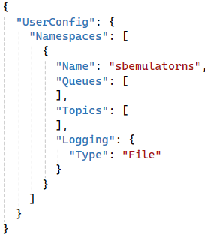
Demonstration
Create Namespace
Notes:
Create an Azure Service Bus Namespace
Typically, we would log into the Azure portal and create an Azure Service Bus namespace; but for this workshop, we are using the local emulator.

Slide 15
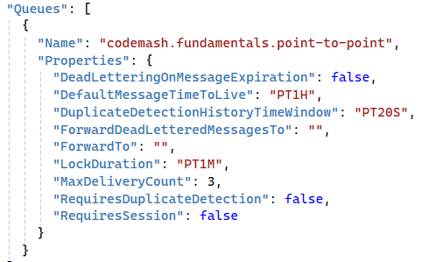
Demonstration
Create Namespace
Create a Queue
Notes:
Create an Azure Service Bus Namespace
Typically, we would log into the Azure portal and create an Azure Service Bus namespace; but for this workshop, we are using the local emulator.

Slide 16
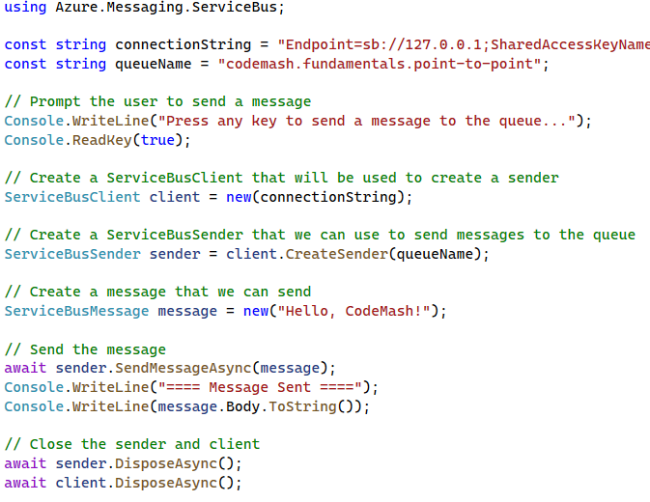
Demonstration
Create Namespace
Create a Queue
Create a Message Producer
Notes:
Create a Message Producer
Use the Azure SDK to send a message to the codemash.fundamentals.point-to-point queue.

Slide 17
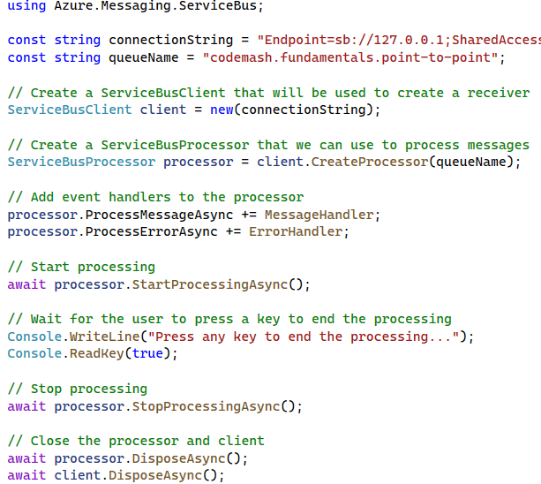
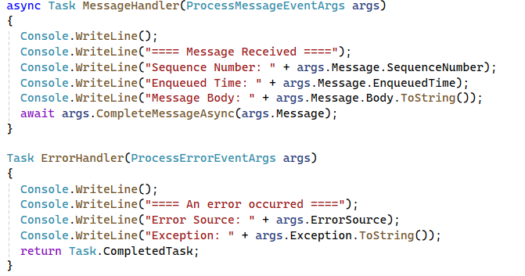
Demonstration
Create Namespace
Create a Queue
Create a Message Producer
Create a Message Consumer
Notes:
Create a Message Consumer
Use the Azure SDK to receive and process messages from the codemash.fundamentals.point-to-point queue.

Slide 18
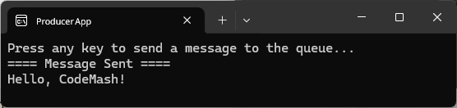
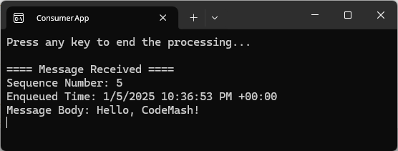
Demonstration
Create Namespace
Create a Queue
Create a Message Producer
Create a Message Consumer
Run the Demo
Notes:
Run the Demo
Execute the producer code to send a message.
Execute the consumer code to receive and process the message.
Observer the message flow from the producer to the consumer.

Slide 19
Key Points to Remember
Ensures messages are processed by one consumer.
Suitable for tasks that require guaranteed delivery to a single receiver.
Helps in decoupling producers and consumers, allowing them to operate independently.

Slide 20
Publish/Subscribe Messaging
Fundamentals of Messaging

Slide 21
What is Pub/Sub Messaging?
Messages published to a topic for multiple subscribers
Enables scalable and flexible communication
Notes:
Definition
Publish/Subscribe (Pub/Sub) messaging is a pattern where message are published to a topic and multiple subscribers receive the message. This allows one-to-many communication.
Purpose
It enable scalable and flexible communication, allowing multiple subscribes to receive the same message simultaneously.

Slide 22
Pub/Sub Key Components & Flow
Message Broker
Publisher
Topic
Subscriptions
Subscribers
Notes:
Message Publisher
The component or service that sends messages to a topic.
Topic
An intermediary channel where messages are published and made available to subscribers.
Message Subscribers
Components or services that subscribe to the topic and receive messages.
Message Broker
An optional intermediary that manages the topic and ensures messages are delivered to all subscribers.

Slide 23
Benefits
Decoupling
Multiple Consumers
Scalability & Flexibility
Notes:
Decouples message producers from consumers.
Supports multiple consumers for the same message.
Enhances scalability and flexibility in message delivery.

Slide 24
Drawbacks
Complexity
Notes:
Complexity in Message Management
Managing message delivery guarantees and ensuring messages are delivered to all subscribers can be complex.
Handling message ordering and duplicates across multiple subscribers adds additional complexity.

Slide 25
Drawbacks
Complexity
Scalability
Notes:
Scalability Challenges
As the number of subscribers grows, the load on the message broker can incr4ease, potentially impacting performance.
Ensuring timely delivery of messages to all subscribers can become more challenging with a high volume of messages.

Slide 26
Drawbacks
Complexity
Scalability
Subscriber Dependency
Notes:
Subscriber Dependency
As the number of subscribers grows, the load on the message broker can increase, potentially impacting performance.
Ensuring timely delivery of message to all subscribers can become more challenging with a high volume of messages.

Slide 27
Drawbacks
Complexity
Scalability
Subscriber Dependency
Resource Utilization
Notes:
Resource Utilization
Maintaining multiple subscriptions and handling message delivery can consumer significant system resources.
Ensuring the message broker has sufficient resources to handle peak loads is essential.

Slide 28
Drawbacks
Complexity
Scalability
Subscriber Dependency
Resource Utilization
Latency
Notes:
Latency
Message delivery to multiple subscribers can introduce latency, especially if the broker needs to handle a large number of messages or subscribers.
Real-time processing requirements may be impacted by the delay in message dissemination.

Slide 29
Drawbacks
Complexity
Scalability
Subscriber Dependency
Resource Utilization
Latency
Error Handling
Notes:
Error Handling
Detecting and handling errors across multiple subscribers can be challenging.
Implementing retry mechanisms and ensuring message integrity requires additional effort.

Slide 30
Drawbacks
Complexity
Scalability
Subscriber Dependency
Resource Utilization
Latency
Error Handling

Slide 31
Use Cases
Broadcasting Events
Real-Time Data Feeds
Alert Systems
Notes:
Broadcasting Events
Notifying multiple services or components about an event, such as a user action or system change.
Real-Time Data Feeds
Distributing real-time data to multiple consumers, such as stock market updates or live sports scores.
Alert Systems
Sending alerts to multiple subscribers like monitoring systems or user devices.

Slide 32
Demonstration
Create Namespace

Slide 33
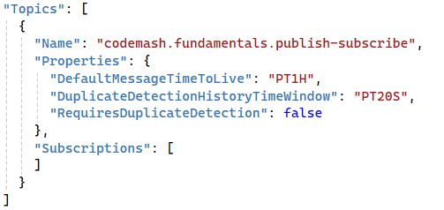
Demonstration
Create Namespace
Create a Topic

Slide 34
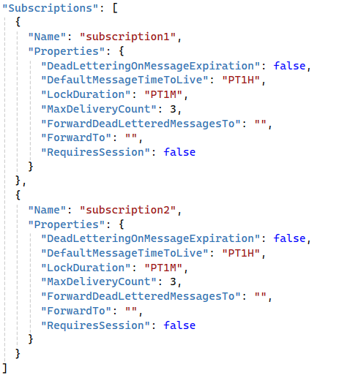
Demonstration
Create Namespace
Create a Topic
Create Subscriptions

Slide 35
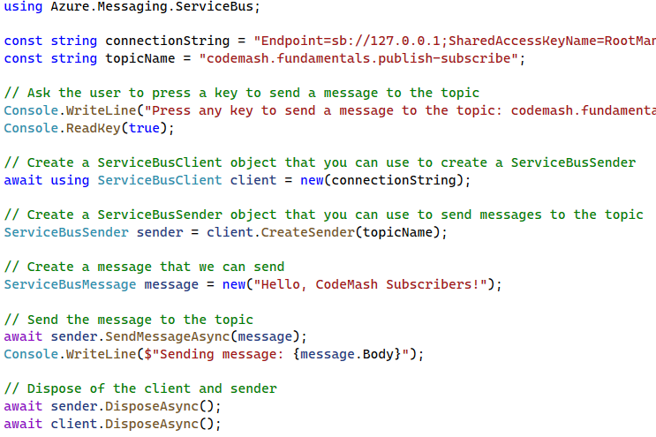
Demonstration
Create Namespace
Create a Topic
Create Subscriptions
Create Message Publisher

Slide 36
Demonstration
Create Namespace
Create a Topic
Create Subscriptions
Create Message Publisher

Slide 37
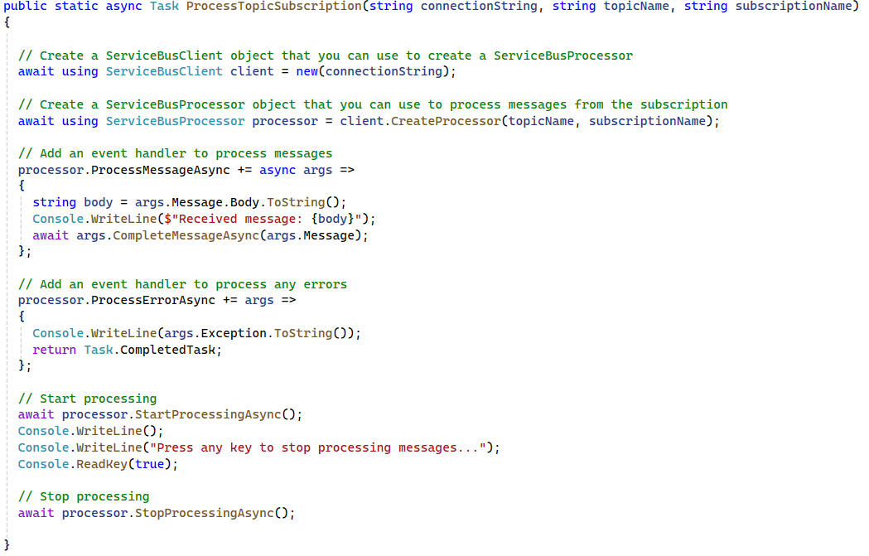
Demonstration
Create Namespace
Create a Topic
Create Subscriptions
Create Message Publisher
Create Subscriber Helper

Slide 38
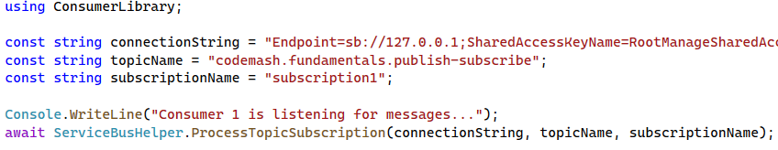
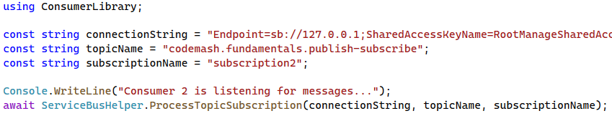
Demonstration
Create Namespace
Consumer 1
Create a Topic
Create Subscriptions
Create Message Publisher
Consumer 2
Create Subscriber Helper
Create Message Subscribers

Slide 39
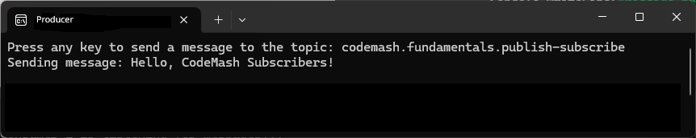
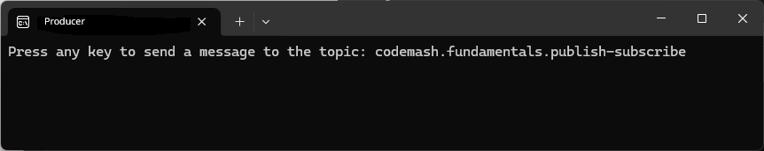
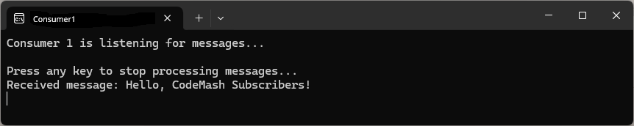
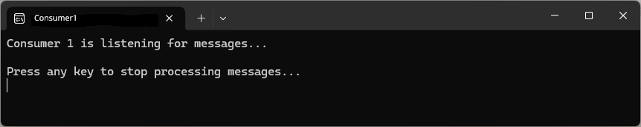
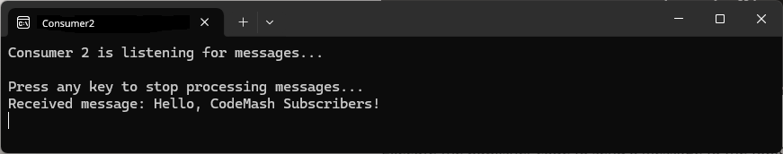
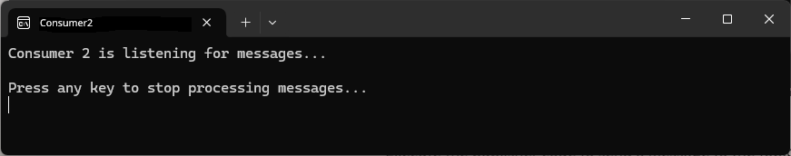
Demonstration
Create Namespace
Create a Topic
Create Subscriptions
Create Message Publisher
Create Subscriber Helper
Create Message Subscribers
Run the Demo

Slide 40
Key Points to Remember
Supports one-to-many message delivery.
Useful for broadcasting events or data to multiple consumers.
Decouples publishers and subscribers, enhancing system flexibility.

Slide 41
Competing Consumers
Fundamentals of Messaging

Slide 42
What is Competing Consumers
Multiple consumers read and process queue
Allows multiple consumers to process message concurrently
Notes:
Definition
Competing Consumers is a messaging pattern where multiple consumers read and process messages from the same queue. This helps distribute the workload and ensures scalability.
Purpose
It allows multiple consumers to process messages concurrently, improving system throughput and reliability.

Slide 43
Key Components & Flow
Message Broker
Producer
Message Queue
Competing Consumers
Notes:
Message Publisher (Sender)
The component or service that creates and sends messages to the queue.
Message Queue
A temporary storage area where messages are held until processed by consumers.
Competing Consumers (Multiple Consumers)
Multiple components or services that read and process message from the queue.
Message Broker
An optional intermediary that manages the queue, ensuring messages are delivered to available consumers.

Slide 44
Benefits
Scalability
Load Balancing
Fault Tolerance
Notes:
Scalability: Increases system throughput by processing multiple message simultaneously.
Load Balancing: Distributes the workload among multiple consumers, preventing bottlenecks.
Fault Tolerance: If one consumer fails can continue processing messages, enhancing reliability.

Slide 45
Drawbacks
Message Ordering
Complexity in Coordination
Resource Contention
Notes:
Message Ordering: Ensuring the order of message processing can be challenging when multiple consumers are involved.
Complexity In Coordination: Managing state and coordination between multiple consumers can add complexity.
Resource Contention: Multiple consumers may contend for resources, requiring careful management of resource allocation.

Slide 46
Use Cases
Task Processing
Data Processing
Order Processing
Notes:
Task Processing
Distributing tasks among multiple workers to balance the load.
Data Processing
Parallel processing of large data sets to improve processing speed.
Data Processing
Handling incoming orders by multiple processing units to ensure timely execution.

Slide 47
Demonstration
Create Namespace

Slide 48
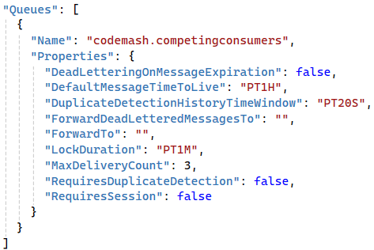
Demonstration
Create Namespace
Create the Message Queue

Slide 49
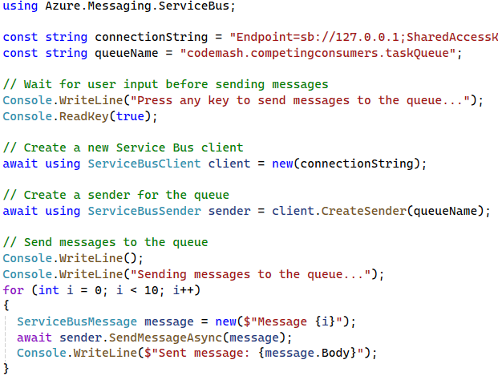
Demonstration
Create Namespace
Create the Message Queue
Create a Message Producer

Slide 50
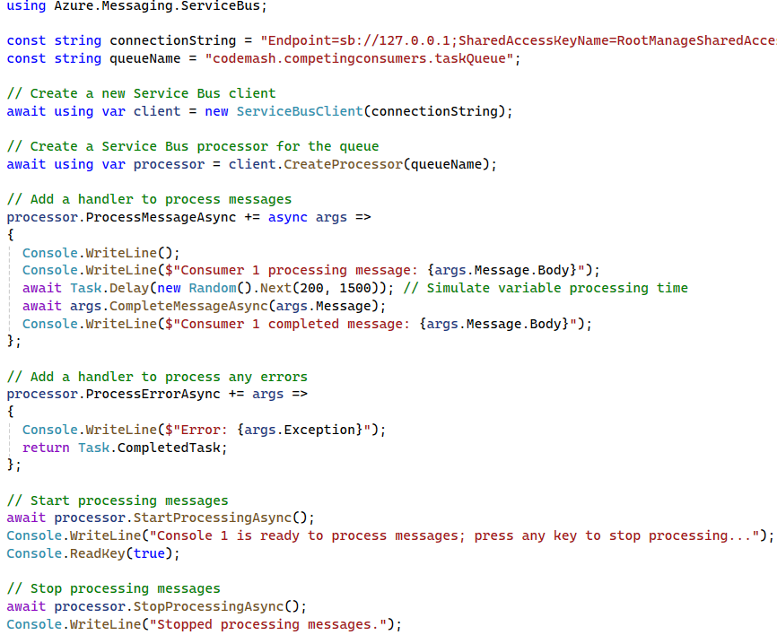

Demonstration
Create Namespace
Create the Message Queue
Create a Message Producer
Create Competing Consumers

Slide 51
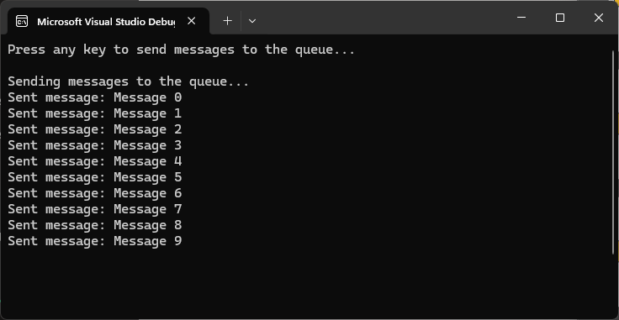
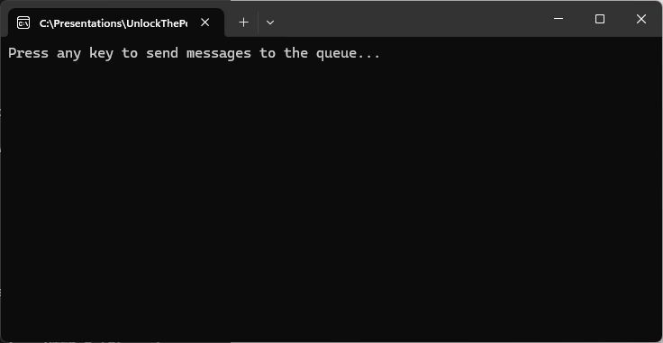
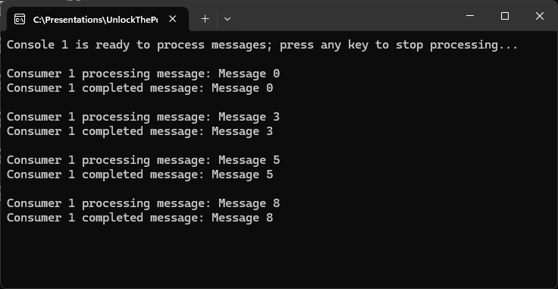
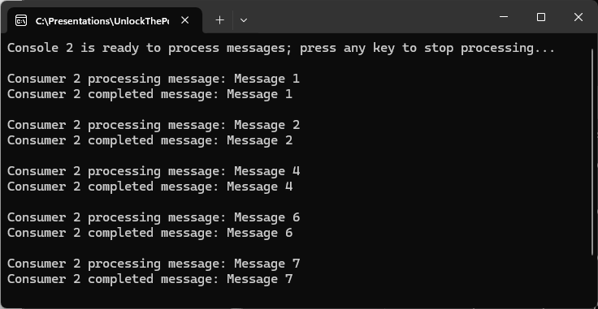
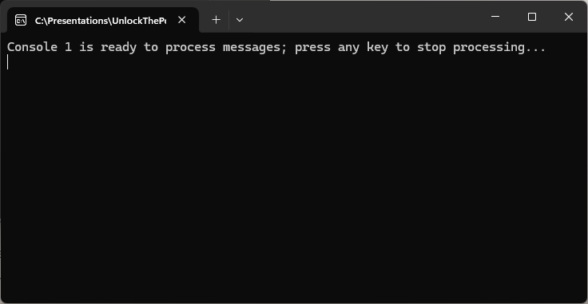
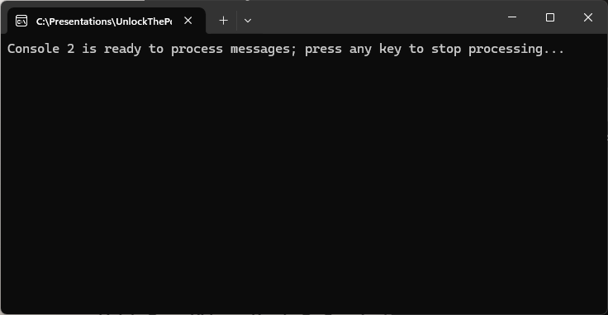
Demonstration
Create Namespace
Create the Message Queue
Create a Message Producer
Create Competing Consumers
Run the Demo

Slide 52
Key Points to Remember
Supports concurrent message processing by multiple consumers.
Enhances system scalability, throughput, and reliability.
Effective for load balancing and fault tolerance.

Slide 53
Request/Reply Messaging
Fundamentals of Messaging

Slide 54
What is Request/Reply Messaging?
Requester waits for a reply message
Enables synchronous communication
Notes:
Definition
Request/Reply messaging is a pattern where a sender sends a request message to a receiver and waits for a reply message. This allows for two-way communication between services or components.
Purpose
It enables synchronous communication where the sender expects a response to its request, often used in scenarios where confirmation or additional data is needed.

Slide 55
Key Components & Flow
Request Queue
Requestor
(Client)
Response Queue
Responder
(Sever)
Message Broker
Notes:
Requestor (Client): The component or service that sends a request message and waits for a reply.
Responder (Server): The component or service that receives the request message, processes it, and sends a reply message.
Message Broker: (Optional) An intermediary that routes messages between the requester and responder, ensuring reliable delivery.

Slide 56
Benefits
Synchronous Communication
Simplified Workflows
Reliability
Control and Coordination
Decoupling
Notes:
Synchronous Communication: Enables real-time interaction between services, where the requester gets an immediate response.
Simplified Workflows: Straightforward to understand and implement, as it follows a direct request-response cycle. Ideal for tasks like querying, data retrieval, and service invocation.
Reliability: Ensures that the requester gets a response, enhancing the reliability of the communication process. Can include error handling and retries to ensure successful message delivery.
Control and Coordination: Allows tight control and coordination between the requester and responder. Facilitates better management of state and session-based interactions.
Decoupling: While enabling synchronous communication, it still decouples the requester and responder, allowing them to evolve independently.

Slide 57
Drawbacks
Scalability
Latency
Resource Utilization
Complexity in Error Handling
Single Point of Failure
Notes:
Scalability Issues: Synchronous nature can lead to bottlenecks, especially under high load, as the requester waits for a response. Difficult to scale when there are many simultaneous requests.
Latency: Introduces latency as the requester has to wait for the responder to process the request and send a response. Not suitable for real-time or low-latency applications.
Resource Utilization: Ties up resources on both the requester and responder sides during the request-response cycle. Can lead to inefficient resource utilization if requests are long-running.
Complexity in Error Handling: Requires robust error handling mechanisms to manage timeouts, retries, and failed requests. More complex to implement reliable messaging guarantees compared to asynchronous patterns.
Single Point of Failure: The responder can become a single point of failure. If it goes down, requesters cannot get responses. Ensuring high availability and fault tolerance becomes crucial.

Slide 58
Use Cases
Service Invocation
Data Retrieval
Status Updates
Notes:
Service Invocation
Calling a service and waiting for a response, such as invoking a web service.
Data Retrieval
Requesting specific information from another service or component and receiving the required data.
Status Updates
Sending a request for the status of a process and receiving a status update in return.

Slide 59
Demonstration
Create Namespace

Slide 60
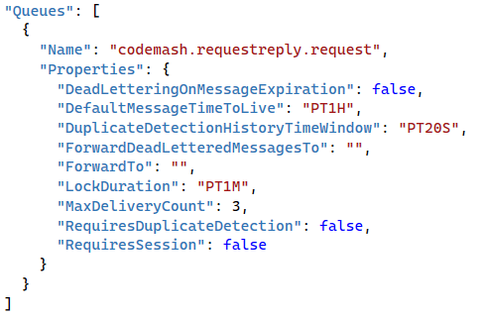
Demonstration
Create Namespace
Create the Request Queue

Slide 61
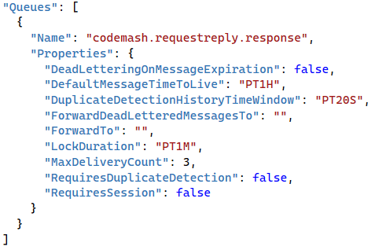
Demonstration
Create Namespace
Create the Request Queue
Create the Response Queue

Slide 62
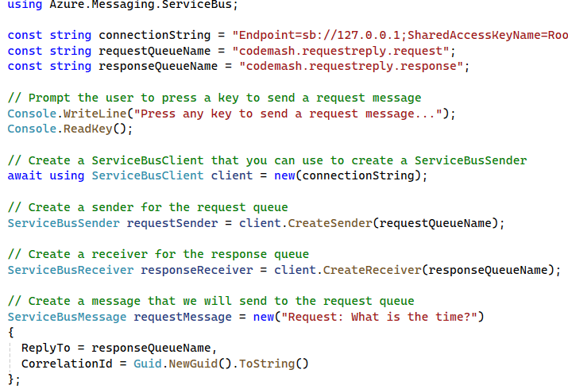
Demonstration
Create Namespace
Create the Request Queue
Create the Response Queue
Create the Requestor

Slide 63
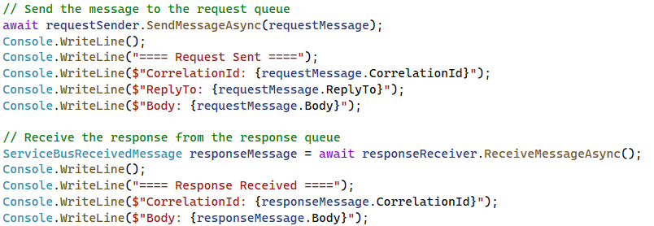
Demonstration
Create Namespace
Create the Request Queue
Create the Response Queue
Create the Requestor

Slide 64
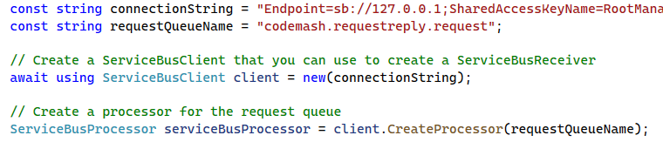
Demonstration
Create Namespace
Create the Request Queue
Create the Response Queue
Create the Requestor
Create the Responder

Slide 65
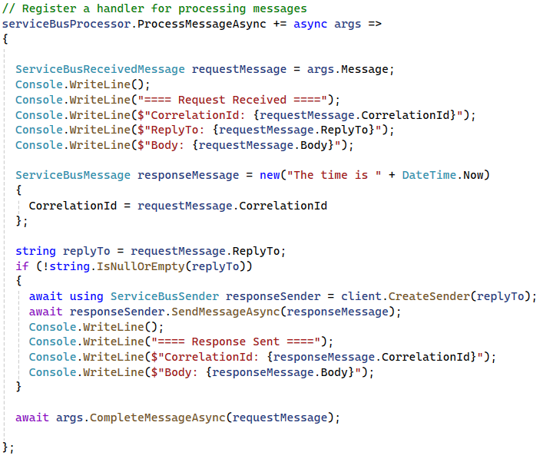
Demonstration
Create Namespace
Create the Request Queue
Create the Response Queue
Create the Requestor
Create the Responder

Slide 66
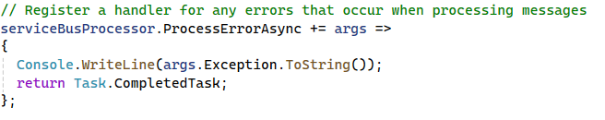
Demonstration
Create Namespace
Create the Request Queue
Create the Response Queue
Create the Requestor
Create the Responder

Slide 67
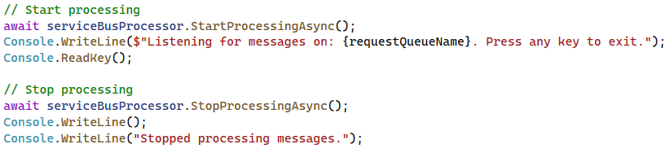
Demonstration
Create Namespace
Create the Request Queue
Create the Response Queue
Create the Requestor
Create the Responder

Slide 68
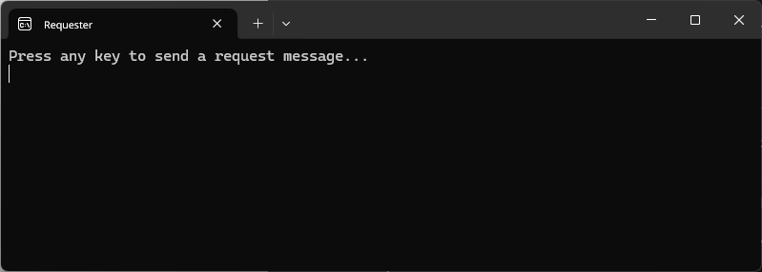
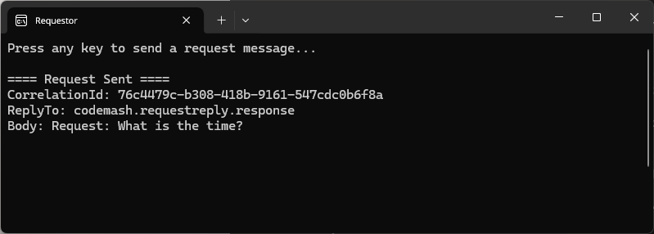
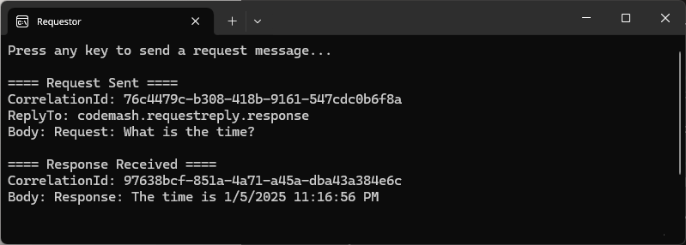
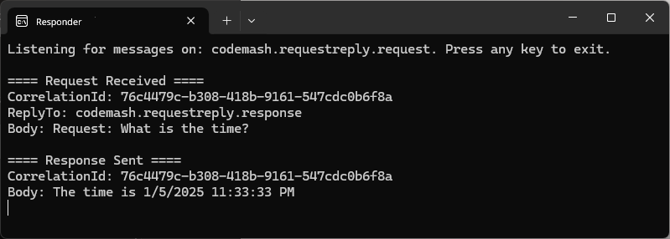
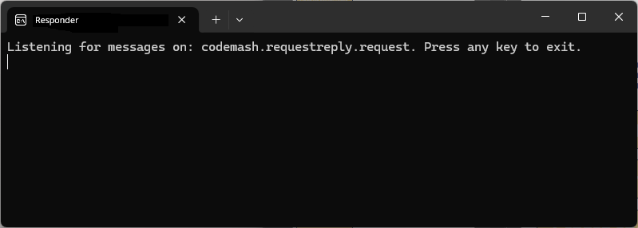
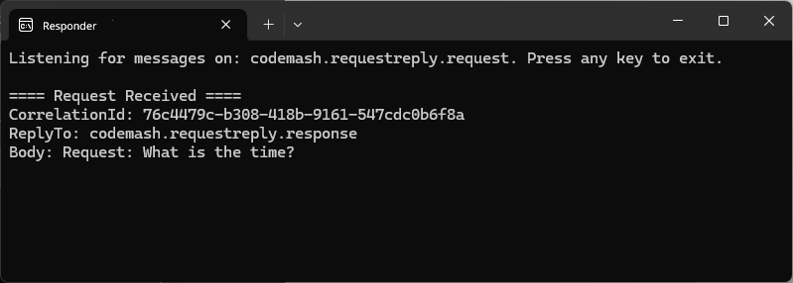
Demonstration
Create Namespace
Create the Request Queue
Create the Response Queue
Create the Requestor
Create the Responder
Run the Demo

Slide 69
Key Points to Remember
Supports two-way communication between services or components.
Suitable for scenarios requiring immediate response or confirmation.
Simplifies synchronous interactions and workflows.

Slide 70
Wrap-Up
Fundamentals of Messaging

Slide 71
When to Use One Over the Others
Point-to-Point
Publish/ Subscribe
Dead Letter Queue
Competing Consumers
Request/Reply

Slide 72
When to Use One Over the Others
Point-to-Point
Publish/ Subscribe
Dead Letter Queue
Competing Consumers
Request/Reply
Notes:
Dead Letter Queue
Handling failed messages by moving them to a secondary queue for troubleshooting and analysis.
When to Use
When you need to handle messages that cannot be processed successfully.
Useful for scenarios where you need to analyze and address problematic messages separately, such as failed transactions or corrupted data.

Slide 73
When to Use One Over the Others
Point-to-Point
Publish/ Subscribe
Competing Consumers
Request/Reply

Slide 74
When to Use One Over the Others
Point-to-Point
Publish/ Subscribe
Competing Consumers
Request/Reply
Notes:
Point-to-Point Messaging
Direct communication between a sender and a receiver, ensuring messages are processed by one consumer.
When to Use
When you need reliable, one-to-one communication between two components.
Ideal for scenarios where each message much be processed by only one receiver, such as task distribution.

Slide 75
When to Use One Over the Others
Point-to-Point
Publish/ Subscribe
Competing Consumers
Request/Reply
Notes:
Publish/Subscribe Messaging
Broadcasting messages to multiple subscribers, allowing one-to-many communication.
When to Use
When you need to broadcast messages to multiple receivers.
Suitable for scenarios where multiple subscribes need to receive and act on the same message, such as notifications or event broadcasting.

Slide 76
When to Use One Over the Others
Point-to-Point
Publish/ Subscribe
Competing Consumers
Request/Reply
Notes:
Competing Consumers Messaging
Multiple consumers processing messages from the same queue, improving system scalability and load balancing.
When to Use
When you need to distribute the processing load among multiple consumers to improve efficiency.
Ideal for scenarios with high message throughput where parallel processing is necessary, such as processing orders or jobs.

Slide 77
When to Use One Over the Others
Point-to-Point
Publish/ Subscribe
Competing Consumers
Request/Reply
Notes:
Request/Reply Messaging
Two-way communication where the sender expects a response, facilitating synchronous interactions.
When to Use
When you need synchronous communication with immediate feedback.
Useful for scenarios where a response is required for each request, such as querying a service or performing an action that needs acknowledgement.

Slide 78
Importance in Building Robust Cloud Applications
Reliability
Scalability
Decoupling
Fault Tolerance
Flexibility
Notes:
Reliability: Ensuring messages are delivered and processed as intended.
Scalability: Distributing workload efficiently across multiple consumers and systems.
Decoupling: Allowing different parts of the application to operate independently.
Fault Tolerance: Managing and recovering from failures to maintain system stability.
Flexibility: Enabling a variety of communication models to suit different use cases.

Slide 79
Preview of What’s Next in the Workshop
Routing and Processing
Advanced Processing Techniques
Resilience and Reliability
Steaming and Integrations
Design Considerations
Hands-On Exercises
Notes:
Routing and Processing: Enhancing message handling and processing efficiency.
Advanced Processing Techniques: Implementing sophisticated techniques for robust messaging.
Resilience and Reliability: Ensuring fault tolerance, resilience, and reliability in messaging.
Streaming and Integration: Leveraging continuous data streams and integrating systems effectively.
Design Considerations: Understanding best practices for designing resilient messaging systems.
Hands-On Exercises: Practical implementations of advanced patterns to reinforce learning.

Slide 80
Preview of Routing and Processing
Message Routing
Dead Letter Queues
Message Filtering
Aggregator
Scatter-Gather
Notes:
We have covered a lot of ground in the Fundaments of Messaging module, giving you a solid foundation in core messaging patterns. Before we conclude this section, let’s take a moment to preview what is coming next in our workshop.
In the Routing and Processing module, we will go deeper into more advanced patterns that enhance message handling and processing efficiency. Here is a sneak peek of what we will explore:
Message Routing: Learn how to direct messages to appropriate endpoints for processing.
Dead Letter Queues: Understand the strategies for handling undeliverable messages.
Message Filtering: Discover techniques to process only the messages that matter to your application.
Aggregator Pattern: See how to combine multiple related messages into a single message.
Scatter-Gather: Explore the methods for splitting a message into sub-messages and reassembling the responses.
These patterns will build on what you have already learned and provide you with powerful tools to design robust and efficient messaging solutions. Stay tuned as we continue to enhance your messaging toolkit.

Slide 81
Routing and Processing
Unlock the Power of Messaging Patterns
Notes:
Welcome to the Routing and Processing module. In this section, we will explore advanced patterns that enhance the efficiency and effectiveness of message handling within distributed systems. Proper routing and processing are crucial for ensuring that messages reach the right destinations and are processed appropriately, thereby enabling seamless communication and coordination between different parts of your application.
By the end of this module, you will be equipped with practical knowledge and techniques to improve your messaging solutions, making them more efficient and reliable. Let’s dive in and explore how to take your message handling capabilities to the next level!

Slide 82
Message Routing
Routing and Processing

Slide 83
What is Messaging Routing
Directs messages to different destinations based on specific criteria
Isolate problematic messages
Notes:
Definition
Messaging routing is a pattern that directs messages to different destinations based on specific criteria. This allows for flexible and dynamic handling of messages.
Purpose
It helps in organizing and managing message flows within a system, ensuring that messages reach the appropriate endpoints for processing.

Slide 84
Key Components & Flow
Message Router
Endpoint A
Endpoint B
Producer
Endpoint B
Consumer(s)
Endpoint A
Notes:
Message Producer
The component or service that creates and sends messages.
Message Router
The intermediary that evaluates messages and determines their destination based on predefined rules or criteria.
Destination Endpoints
The components or services that receive and process the routed messages.

Slide 85
Key Components & Flow
Message Router
High Priority
Low Priority
Producer
Consumer
Low Priority
High Priority
Notes:
Message Producer
The component or service that creates and sends messages.
Message Router
The intermediary that evaluates messages and determines their destination based on predefined rules or criteria.
Destination Endpoints
The components or services that receive and process the routed messages.

Slide 86
Benefits
Flexibility
Scalability
Organization
Notes:
Flexibility: Enables dynamic routing of messages based on various criteria.
Scalability: Supports efficient distribution of messages to balance the load across multiple consumers or services.
Improved Organization: Helps in managing and organizing message flows within complex systems.

Slide 87
Drawbacks
Complexity
Overhead
Scalability
Notes:
Increased Complexity
Rule Management: Defining and managing routing rules can become complex, especially in dynamic environments where requirements frequently change. This complexity grows as the number of routing criteria and endpoints increases.
Configuration Overhead: Ensuring that all routing configurations are accurate and up-to-date requires significant effort and careful management. Misconfigurations can lead to incorrect routing, causing processing delays or errors.
Performance Overhead
Latency: Each routing decision adds processing time, which can introduce latency, particularly in high-throughput systems where quick message delivery is crucial.
Resource Consumption: The message router itself cane become a bottleneck if it is not adequately scaled or optimized, consuming considerable computational and network resources to process and route messages efficiently.
Scalability Challenges
Load Distribution: While routing helps balance load, ensuring that the message router scales effectively to handle varying loads can be challenging. If not properly managed, the router can become a single point of failure or performance bottleneck.
Reliability: Ensuring reliable message routing in a distributed system requires robust error handling and retry mechanisms. Any failure in the routing logic or in the router itself can disrupt the message flow, leading to potential data loss or processing delays.

Slide 88
Use Cases
Load Balancing
Content-Based Routing
Priority Routing
Notes:
Load Balancing
Distributing message to different servers or services based on load or capacity.
Content-Based Routing
Directing messages to different endpoints based on the content of the message.
Priority Routing
Routing messages based on their priority or urgency to ensure timely processing.

Slide 89
Demonstration
Create Namespace

Slide 90
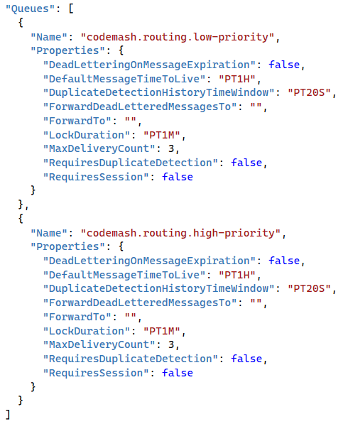
Demonstration
Create Namespace
Create the Message Queues

Slide 91
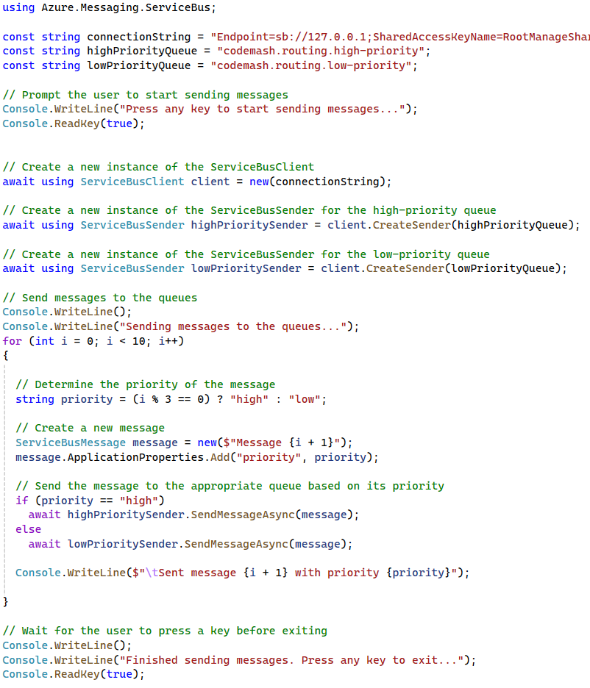
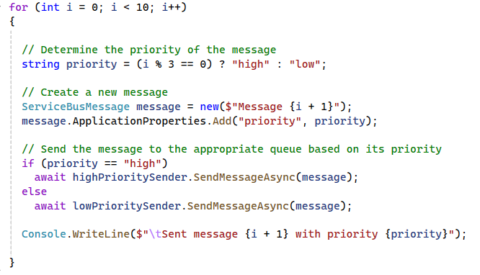
Demonstration
Create Namespace
Create the Message Queue
Create a Message Producer

Slide 92
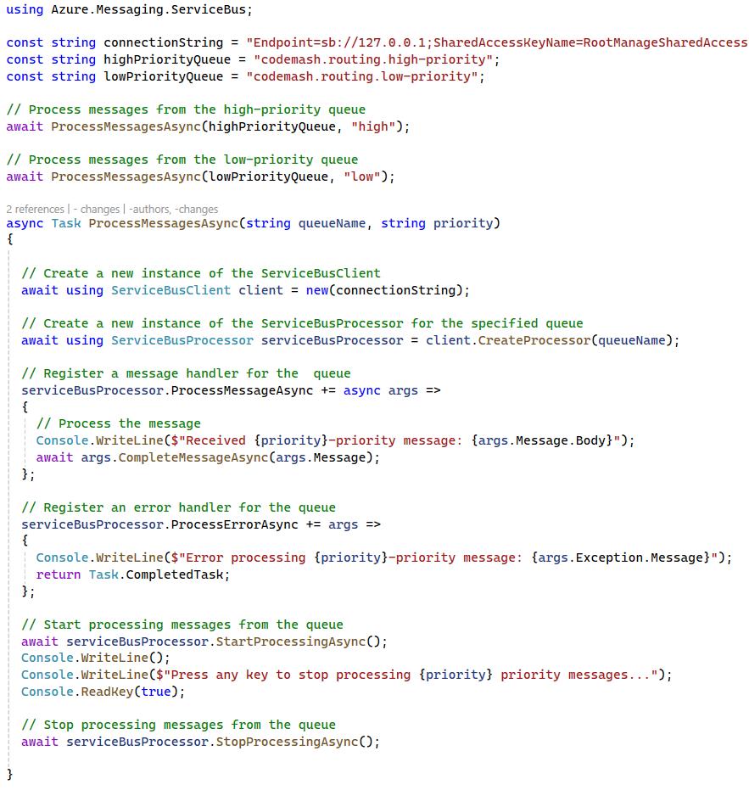
Demonstration
Create Namespace
Create the Message Queue
Create a Message Producer
Create a Message Consumer

Slide 93
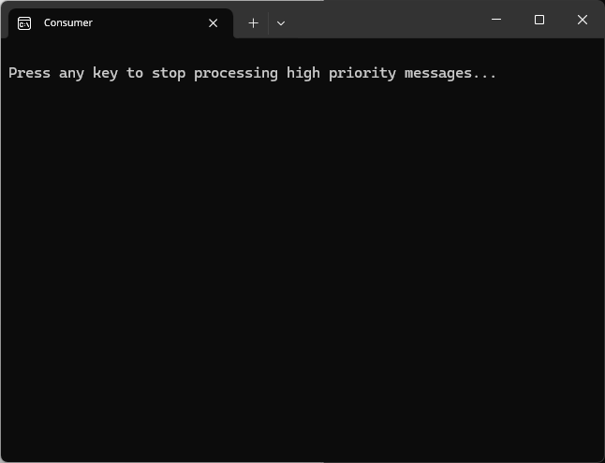
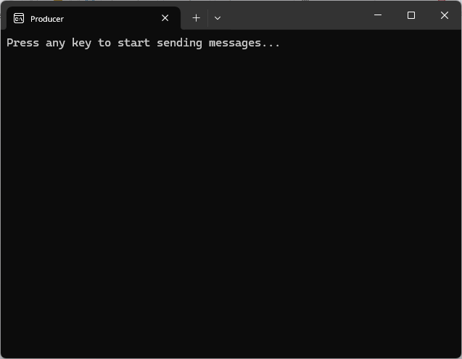
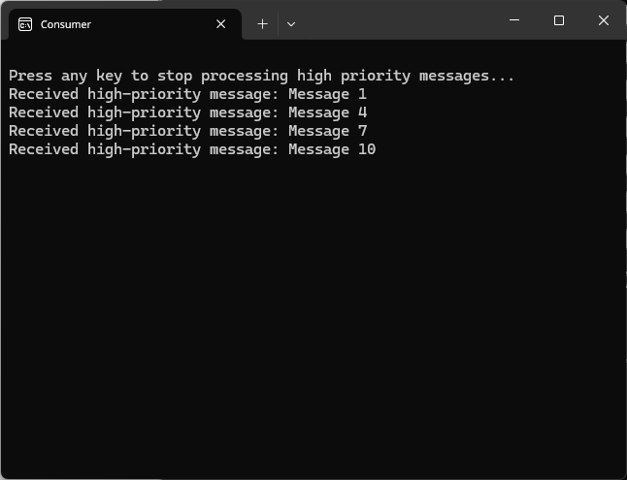
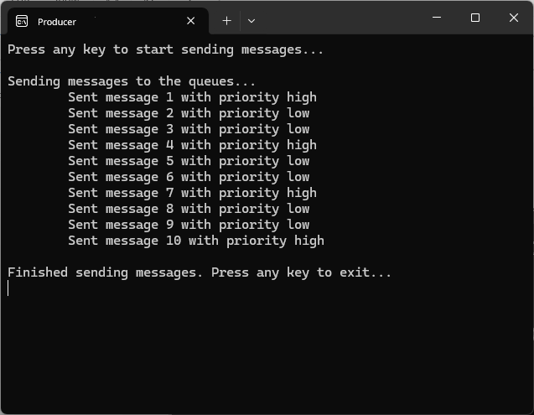

Demonstration
Create Namespace
Create the Message Queue
Create a Message Producer
Create Competing Consumers
Run the Demo

Slide 94
Key Points to Remember
Supports flexible and dynamic routing of messages.
Enhances system scalability and load balancing.
Facilitates efficient organization and management of message flows.

Slide 95
Dead Letter Queues
Routing and Processing

Slide 96
What are Dead Letter Queues
Secondary queue of unprocessable messages
Isolate problematic messages
Notes:
Definition
A Dead Letter Queue is a secondary queue used to hold messages that cannot be processed successfully. These messages are typically moved to the Dead Letter Queue after several failed processing attempts or when they exceed their time-to-live (TTL).
Purpose
Dead Letter Queues help in isolating problematic messages, allowing for troubleshooting and analysis without affecting the normal message flow.

Slide 97
Key Components & Flow
Message Broker
Producer
Consumer
Message Queue
Dead Letter Queue
Notes:
Message Queue
The main queue where message are initially sent and processed.
Message Producer (Sender)
The component or service that creates and sends message to the primary queue.
Message Consumer (Receiver)
The component or service that processes messages from the primary queue and moves failed messages to the Dead Letter Queue
Message Broker
An optional intermediary that manages the primary and dead letter queues, ensuring messages are properly routed.
Dead Letter Queue
The secondary queue where failed messages are moved after processing attempts fail.

Slide 98
Benefits
Reliability
Troubleshooting
Efficiency
Notes:
Improved Reliability: Ensures that problematic messages do not block the message processing pipeline.
Simplified Troubleshooting: Provides a clear location to analyze and debug failed messages.
Operational Efficiency: Allows normal message processing to continue without interruption.

Slide 99
Drawbacks?
Complexity
Delayed Processing
Data Loss Potential
Notes:
Increased Complexity
Management Overhead: Handling Dead Letter Queues adds complexity to the system. Developers need to implement logic to manage failed messages and ensure they are moved to the Dead Letter Queue appropriately.
Monitoring and Maintenance: Regular monitoring and maintenance of Dead Letter Queues are required to ensure they do not get overloaded or ignored. This adds an additional layer of operational overhead.
Delayed Processing
Resolution Time: Messages in the Dead Letter Queue are not processed until they are manually inspected and resolved. This can lead to significant delays in addressing the issues, especially if the Dead Letter Queue is not monitored regularly.
Resource Allocation: Allocating resources for monitoring and processing Dead Letter Queues can impact the system’s overall efficiency, as resources could be tied up dealing with problematic messages instead of handling regular operations.
Potential for Data Loss
Misconfiguration Risks: Incorrect configuration or improper handling of Dead Lead Queues can lead to data loss. For example, if message are moved to the Dead Letter Queue without proper logging or tracking, they may be overlooked and not processed.
Manual Intervention Dependency: Since Dead Letter Queues often require manual intervention to resolve issues. There is a risk of human error or oversight, which could result in important messages being lost of forgotten.

Slide 100
Use Cases
Error Handling
Message Expiry
Monitoring & Troubleshooting
Notes:
Error Handling
Capturing messages that cannot be processed due to errors such as format issues or missing data.
Message Expiry
Handling messages that have exceeded their TTL without being processed.
Monitoring and Troubleshooting
Analyzing message in the Dead Letter Queue to identify patterns and root causes of failures.

Slide 101
Demonstration
Create Namespace

Slide 102

Demonstration
Create Namespace
Create the Message Queue

Slide 103

Demonstration
Create Namespace
Create the Message Queue
Create a Message Producer

Slide 104


Demonstration
Create Namespace
Create the Message Queue
Create a Message Producer
Create a Message Consumer

Slide 105


Demonstration
Create Namespace
Create the Message Queue
Create a Message Producer
Create a Message Consumer
Create a DLQ Consumer

Slide 106






Demonstration
Create Namespace
Create the Message Queue
Create a Message Producer
Create Competing Consumers
Create a DLQ Consumer
Run the Demo

Slide 107
Key Points to Remember
Helps in isolating and handling problematic messages.
Facilitates troubleshooting and improves system reliability.
Ensures that normal message processing continues without disruption.

Slide 108
Message Filtering
Routing and Processing

Slide 109
What is Messaging Filtering
Consumers selectively receive messages based on criteria or filters.
Isolate problematic messages
Notes:
Definition
Messaging filtering is a pattern that allows consumers to selectively receive messages based on specific criteria or filters. This enables more efficient and targeted message processing.
Purpose
It helps in directing relevant messages to the appropriate consumers, reducing the overhead of processing irrelevant messages.

Slide 110
Key Components & Flow
Subscriptions
Message Router
Subscription A
Topic
Subscription B
Producer
Consumers
Subscription B
Subscription A
Notes:
Message Producer
The component or service that creates and sends messages.
Message Filter
The intermediary that evaluates messages and determines whether they meet the criteria for delivery to specific consumers.
Filtered Consumers
The components or services that receive and process messages that match their filter criteria.

Slide 111
Benefits
Efficiency
Scalability
Flexibility
Notes:
Efficiency: Reduces the processing load on consumers by filtering out irrelevant messages.
Scalability: Supports targeted message delivery, which can improve overall system performance.
Flexibility: Enables consumers to dynamically adjust their subscriptions and filters based on changing requirements.

Slide 112
Drawbacks
Complexity
Overhead
Scalability
Notes:
Complexity in Filter Management
Rule Configuration: Defining and maintaining filtering rules can become complex, especially in systems with a large number of filters or rapidly changing requirements. As filters grow in number and complexity, managing them effectively can be challenging.
Dynamic Adjustments: Adjusting filters dynamically based on changing needs requires sophisticated logic and careful management to ensure that relevant messages are not missed.
Performance Overhead
Processing Load: Evaluating each message against multiple filters can introduce performance overhead. In high-throughput systems, this additional processing can lead to increased latency and reduced overall system performance.
Resource Utilization: The filter process consumers computational resources which can impact the performance of other system components, especially when dealing with large volumes of message.
Scalability Challenges
Filter Scalability: Scaling the filtering mechanism to handle a high number of filters and large volumes of messages can be difficult. Ensuring that the filtering system can scale efficiently while maintaining performance is crucial.
Distributed Filtering: In distributed systems, ensuring consistent and synchronized filtering across multiple nodes or services can add complexity and post scalability challenges.

Slide 113
Use Cases
Subscription Filtering
Data Segmentation
Notification Systems
Notes:
Subscription Filtering
Allowing consumers to subscribe to only the messages they are interested in,. Based on attributes like type, priority, or content.
Data Segmentation
Directing specific types of data to different processing pipelines, such as separating financial transactions from other types of messages.
Notification Systems
Sending notifications to users based on their preferences or subscriptions.

Slide 114
Demonstration
Create Namespace

Slide 115



Demonstration
Create Namespace
Create Topic & Subscriptions

Slide 116

Demonstration
Create Namespace
Create Topic & Subscriptions
Create a Message Producer

Slide 117

Demonstration
Create Namespace
Create Topic & Subscriptions
Create a Message Producer
Create a Message Consumers

Slide 118






Demonstration
Create Namespace
Create Topic & Subscriptions
Create a Message Producer
Create Competing Consumers
Run the Demo

Slide 119
Key Points to Remember
Supports selective message delivery based on specific criteria.
Enhances efficiency and scalability of message processing.
Provides flexibility for consumers to adjust their subscription and filters.

Slide 120
Aggregator Pattern
Routing and Processing

Slide 121
What is the Aggregator Pattern
Multiple message collected and processed as a single unit
Aggregate related information for various sources
Notes:
Definition
The Aggregator Pattern is a messaging pattern where multiple message are collected and processed as a single unit. This allows for batch processing and consideration of data from different sources.
Purpose
It helps in aggregating related information from various sources and presenting it as a unified, cohesive output.

Slide 122
Key Components & Flow
Input
Output
Consumer
Aggregator
Producers
Notes:
Message Producers (Senders)
Components or services that create and send individual messages to be aggregated.
Aggregator
The intermediary that collects and processes multiple messages, combining them into a single output.
Aggregated Output
The final, consolidated output that results from aggregating the individual messages.

Slide 123
Benefits
Efficiency
Unified View
Scalability
Notes:
Efficiency: Reduces the overhead of processing individual messages by handling them in batches.
Unified View: Provides a consolidated view of related information, simplifying analysis and decision-making.
Scalability: Supports scalable processing of large volumes of messages by aggregating them into manageable units.

Slide 124
Drawbacks
Latency
Complexity
Resource Utilization
Notes:
Increased Latency
Delayed Processing: Since the aggregator waits to collect multiple message before processing them, there can be a delay in processing individual messages. This latency can be problematic for time-sensitive applications that require immediate processing of each message.
Batch Waiting Time: The aggregator might have to wait until it receives enough messages to form a batch, which can introduce further delays, especially if messages arrive sporadically or unevenly.
Complexity in Implementation and Management
Aggregation Logic: Implementing the logic to collect, combine, and process multiple messages can be complex. It requires careful design to ensure that the aggregation process is efficient and handles edge cases, such as missing or duplicate messages.
State Management: The aggregator needs to manage the state of partial aggregations, which adds to the complexity. This involves tracking which messages have been received, handling timeouts, and ensuring data consistency.
Resource Utilization
Memory and Storage: The aggregator needs to store all the incoming message until they are processed, which can consume significant memory and storage resources, especially when dealing with large volumes of messages.
Processing Overhead: Aggregating and processing multiple messages as a single unit can increase the computation load. This processing overhead can impact the performance and scalability of the system if not managed properly.

Slide 125
Use Cases
Batch Processing
Data Consolidation
Event Correlation
Notes:
Batch Processing
Collecting and processing multiple messages in a single batch to improve efficiency.
Data Consolidation
Aggregating data form different sources for reporting, analysis, or storage.
Event Correlation
Combining related events form different systems to provide a comprehensive view of a process or transaction.

Slide 126
Demonstration
Create Namespace

Slide 127

Demonstration
Create Namespace
Create Queues

Slide 128

Demonstration
Create Namespace
Create Queues
Create the Producer

Slide 129

Demonstration
Create Namespace
Create Queues
Create the Producer
Create the Aggregator

Slide 130

Demonstration
Create Namespace
Create Queues
Create the Producer
Create the Aggregator

Slide 131

Demonstration
Create Namespace
Create Queues
Create the Producer
Create the Aggregator

Slide 132

Demonstration
Create Namespace
Create Queues
Create the Producer
Create the Aggregator

Slide 133

Demonstration
Create Namespace
Create Queues
Create the Producer
Create the Aggregator
Create the Consumer

Slide 134






Demonstration
Create Namespace
Create Queues
Create the Producer
Create the Aggregator
Create the Consumer
Run the Demo

Slide 135
Key Points to Remember
Aggregates related messages for batch processing and data consolidation.
Enhances efficiency and scalability by reducing the overhread of processing individual messages.
Provides a unified view of related information, simplifying analysis and decision-making.

Slide 136
Scatter-Gather Pattern
Routing and Processing

Slide 137
What is the Aggregator Pattern
Request sent to multiple recipients and responses are aggregated
Parallel processing and aggregation of results
Notes:
Definition
The Scatter-Gather Pattern is a messaging pattern where a request is sent to multiple recipients (scatter), and the responses are collected and processed (gather) to produce a final aggregated result.
Think like a loan broker service
Purpose
It enables parallel processing and aggregation of results from multiple services or components, improving efficiency and performance.

Slide 138
Key Components
Requester
Scattered Recipients
Gatherer
Component or service that initiates the scatter request and waits for the gathered responses.
Multiple components or services that receive the scatter request and process it in parallel.
The component or service that collects the responses from the scattered recipients, aggregates them, and produces the final result.
Notes:
Requester
The component or service that initiates the scatter request and waits for the gathered responses.
Scattered Recipients
Multiple components or services that receive the scatter request and process it in parallel.
Gatherer
The component or service that collects the responses from the scattered recipients, aggregates them, and produces the final result.

Slide 139

Flow
Requester
Scattered Recipients
Gatherer
Notes:
Requester
The component or service that initiates the scatter request and waits for the gathered responses.
Scattered Recipients
Multiple components or services that receive the scatter request and process it in parallel.
Gatherer
The component or service that collects the responses from the scattered recipients, aggregates them, and produces the final result.

Slide 140
Benefits
Efficiency
Scalability
Resilience
Notes:
Efficiency: Improves overall system efficiency by leveraging parallel processing.
Scalability: Supports scalable processing by distributing tasks across multiple services.
Resilience: Enhances system resilience by allowing multiple services to contribute to the final result, reducing the impact of individual service failures.

Slide 141
Drawbacks
Complexity
Latency
Scalability
Notes:
Complexity in Implementation and Coordination
Orchestration: Coordinating the scattering of requests and the gathering of responses requires careful orchestration. It can be complex to manage the synchronization of responses handle partial failures, and ensure consistency.
Error Handling: Dealing with errors and timeouts from scattered recipients adds to the complexity. Implementing robust error handling and retry mechanisms is crucial to ensure reliable processing.
Latency and Performance Overhead
Response Time: The overall response time is dependent on the slowest recipient. If any of the scattered recipients tak longer to process the request, it can delay the final aggregated result.
Network and Resource Utilization: The scattering of requests to multiple recipients can introduce network overhead and increase resource consumption. This can impact the performance and scalability of the system.
Scalability Challenges
Load Management: Ensuring that the scattered recipients can handle the distributed load effectively is crucial. It not properly managed, some recipients might become overloaded, leading to performance degradation or failures.
Data Consistency: Maintaining data consistency across multiple scattered recipients can be challenging. Ensuring that all resources are accurately collected and aggregated requires careful design and implementation.

Slide 142
Use Cases
Parallel Processing
Data Aggregation
Load Balancing
Notes:
Parallel Processing
Distributing tasks to multiple services or components for parallel execution, such as querying different databases or performing computations.
Data Aggregation
Collecting and consolidating results from multiple sources to provide a comprehensive view, such as aggregating search results or financial results.
Load Balancing
Distributing workload across multiple services to balance the load and improve system performance.

Slide 143
Demonstration
Create Namespace

Slide 144

Demonstration
Create Namespace
Create Topic & Subscriptions

Slide 145

Demonstration
Create Namespace
Create Topic & Subscriptions
Create Queues

Slide 146

Demonstration
Create Namespace
Create Topic & Subscriptions
Create Queues
Create Requester

Slide 147

Demonstration
Create Namespace
Create Topic & Subscriptions
Create Queues
Create Requester

Slide 148

Demonstration
Create Namespace
Create Topic & Subscriptions
Create Queues
Create Requester
Create Recipients

Slide 149
Demonstration
Create Namespace
Create Topic & Subscriptions
Create Queues
Create Requester
Create Recipients

Slide 150

Demonstration
Create Namespace
Create Topic & Subscriptions
Create Queues
Create Requester
Create Recipients

Slide 151

Demonstration
Create Namespace
Create Topic & Subscriptions
Create Queues
Create Requester
Create Recipients

Slide 152

Demonstration
Create Namespace
Create Topic & Subscriptions
Create Queues
Create Requester
Create Recipients

Slide 153

Demonstration
Create Namespace
Create Topic & Subscriptions
Create Queues
Create Requester
Create Recipients

Slide 154

Demonstration
Create Namespace
Create Topic & Subscriptions
Create Queues
Create Requester
Create Recipients

Slide 155
Demonstration
Create Namespace
Create Topic & Subscriptions
Create Queues
Create Requester
Create Recipients
Run the Demo

Slide 156











Requester
Recipients
Gatherer

Slide 157
Key Points to Remember
Aggregates related messages for batch processing and data consolidation.
Enhances efficiency and scalability by reducing the overhead of processing individual messages.
Provides a unified view of related information, simplifying analysis and decision-making.

Slide 158
Wrap-Up
Routing and Processing

Slide 159
Routing and Processing Wrap-Up
Message Routing
Dead Letter Queues
Message Filtering
Aggregator
Scatter-Gather
Notes:
As we conclude the Routing and Processing module, let’s take a moment to reflect on what we have learned and preview what is coming next.
Messaging Routing: Understating how to direct message to appropriate endpoints.
Dead Letter Queue: Strategies for handling underivable messages.
Message Filtering: Techniques to process only the messages that matter.
Aggregator Pattern: Combining multiple related messages into a single message.
Scatter-Gather: Splitting messages into sub-messages and reassembling the responses.
These patterns have equipped you with the essential tools to enhance the efficiency and reliability of your messaging solutions.

Slide 160
Preview: Advanced Processing Techniques
Idempotent Receiver
Message Scheduling
Transactional Queues
Claim Check
Notes:
In the next module, we will look into more sophisticated techniques to ensure robust messaging. Here is what to look forward to:
Idempotent Receiver: Ensuring messages are processed safely multiple times.
Message Scheduling: Delaying message processing until the right moment.
Transactional Queues: Guaranteeing message integrity within transactions.
Claim Check: Offloading large messages from the queue efficiently.
These advanced techniques will further strengthen your ability to design and implement scalable messaging solutions. Stay tuned as we continue our journey into the world of messaging patterns!

Slide 161
Advanced Processing Techniques
Unlock the Power of Messaging Patterns
Notes:
Welcome to the Advanced Processing Techniques module. In this section, we will explore sophisticated patterns that elevate the reliability and efficiency of your messaging solutions. These advanced techniques are crucial for handling complex messaging scenarios and ensuring that your systems can scale and perform under various conditions.
BY the end of this module, you will be equipped with the knowledge to implement advanced processing techniques, making your messaging systems more resilient and efficient. So, let’s enhance your messaging capabilities to tackle even the most challenging scenarios!

Slide 162
Idempotent Receiver Pattern
Advanced Processing Techniques

Slide 163
What is the Idempotent Receiver Pattern
Ensures message is processed exactly once
Prevent duplicate processing of messages
Notes:
Definition
The Idempotent Receiver pattern ensures that a message is processed exactly once, even if the message is received multiple times. This is achieved by designing the receiver to recognize and discard duplicate messages.
Purpose
The purpose of the Idempotent Receiver pattern is to prevent duplicate processing of messages, ensuring reliable and accurate message handling.

Slide 164
Key Components and Flow
Unique Message Identifiers
State Storage
Idempotent Processing Logic
Notes:
Unique Message Identifiers: Use unique identifiers for each message to track which messages have been processed.
State Storage: Maintain a state storage system (e.g., database, in-memory cache) to store and check the processing status of messages.
Idempotent Processing Logic: Implement logic in the receiver to check for duplicate messages and discard them if they have already been processed.

Slide 165

Key Components and Flow
Unique Message Identifiers
1
State Storage
2
2
4
4
3
1
2
2
2
3
3
4
2
3
4
1
4
3
Idempotent Processing Logic
4
Notes:
Unique Message Identifiers: Use unique identifiers for each message to track which messages have been processed.
State Storage: Maintain a state storage system (e.g., database, in-memory cache) to store and check the processing status of messages.
Idempotent Processing Logic: Implement logic in the receiver to check for duplicate messages and discard them if they have already been processed.

Slide 166
Benefits
Data Integrity
Reliability
Efficiency
Notes:
Data Integrity: Ensures that each message is processed exactly once, maintaining accurate and consistent data.
Reliability: Prevents duplicate processing, reducing the risk of errors and inconsistencies in the system.
Efficiency: Minimizes unnecessary processing by discarding duplicate messages, optimizing resource usage.

Slide 167
Drawbacks
Complexity
State Management
Notes:
Complexity: Implementing idempotent processing logic adds complexity to the system design.
State Management: Requires maintaining state information to identify and discard duplicate messages.

Slide 168
Use Cases
Payment Processing
Order Management
Inventory Updates
Notes:
Payment Processing
Ensuring that payment transactions are processed only once, even if the payment request is received multiple times due to network issues.
Order Management
Preventing duplicate order creation when multiple requests are received for the same order.
Inventory Updates
Ensuring inventory counts are updated correctly without duplication when the same update message is received more than once.

Slide 169
Demonstration
Create Namespace

Slide 170

Demonstration
Create Namespace
Create Queue

Slide 171

Demonstration
Create Namespace
Create Queue
Create Entity

Slide 172

Demonstration
Create Namespace
Create Queue
Create Entity
Create Producer

Slide 173

Demonstration
Create Namespace
Create Queue
Create Entity
Create Producer
Create Receiver

Slide 174
Demonstration
Create Namespace
Create Queue
Create Entity
Create Producer
Create Receiver

Slide 175

Demonstration
Create Namespace
Create Queue
Create Entity
Create Producer
Create Receiver

Slide 176




Demonstration
Create Namespace
Create Queue
Create Entity
Create Producer
Create Receiver
Run the Demo

Slide 177
Key Points to Remember
Use Unique Identifiers
Maintain Processing State
Implement Idempotent Logic
Monitor and Audit
Notes:
Use Unique Identifiers: Assign unique identifiers to each message to facilitate tracking and identification.
Maintain Processing State: Use state storage to keep track of processed messages and prevent duplicate processing.
Implement Idempotent Logic: Design the receiver to recognize and discard duplicate messages based on their unique identifiers.
Monitor and Audit: Continuously monitor the system and audit message processing to ensure the idempotent receiver is functioning correctly.,

Slide 178
Message Scheduling Pattern
Advanced Processing Techniques

Slide 179
What is the Message Scheduling Pattern
Delaying the processing of a message.
Enable system to handle tasks at appropriate times
Notes:
Definition
Message scheduling involves delaying the processing of a message until a specified date or condition is met. This pattern allows message to be processed at a further date or after certain conditions are satisfied.
Purpose
The purpose of message scheduling is to provide controlled and timed message processing, enabling the system to handle tasks at appropriate times or under specific conditions.

Slide 180
Key Components and Flow
Scheduler
Queue
Time-based Triggers
Notes:
Scheduler: A component responsible for scheduling messages to be processed at a specific time or after certain conditions are met.
Queue: A message queue that holds scheduled messages until their scheduled processing time arrives.
Time-Based Triggers: Mechanisms that trigger the processing of scheduled messages at the appropriate time.

Slide 181
Key Components and Flow
Scheduler
Queue
1 min
1 min
1 min
1 min
1 min
1 min
Time-based Triggers
Notes:
Unique Message Identifiers: Use unique identifiers for each message to track which messages have been processed.
State Storage: Maintain a state storage system (e.g., database, in-memory cache) to store and check the processing status of messages.
Idempotent Processing Logic: Implement logic in the receiver to check for duplicate messages and discard them if they have already been processed.

Slide 182
Benefits
Controlled Processing
Resource Optimization
Improved Reliability
Notes:
Controlled Processing: Allows for precise control over when messages are processed, improving system flexibility and efficiently.
Resource Optimization: Enables deferred processing during off-peak hours, reducing the load on the system during busy period.
Improved Reliability: Provides a mechanism for retrying failed messages without immediate reproducing, allowing time for transient issues to be resolved.

Slide 183
Drawbacks
Complexity
Potential Delays
Notes:
Complexity: implementing message scheduling adds complexity in the system design.
Potential Delays: Introduces delays in message processing, which may not be suitable for time-sensitive tasks.

Slide 184
Use Cases
Delayed Notifications
Batch Processing
Retry Logic
Notes:
Delayed Notifications
Sending notifications or alerts at a scheduled time, such as reminders for appointments or follow-up messages.
Batch Processing
Deferring the processing of messages until off-peak hours to optimize resource usage and system performance.
Retry Logic
Scheduling retries for failed messages to be processed at a later time, allowing transient issues to resolve.

Slide 185
Demonstration
Create Namespace

Slide 186

Demonstration
Create Namespace
Create Queue

Slide 187

Demonstration
Create Namespace
Create Queue
Create Producer

Slide 188

Demonstration
Create Namespace
Create Queue
Create Producer
Create Consumer

Slide 189





Demonstration
Create Namespace
Create Queue
Create Producer
Create Consumer
Run the Demo

Slide 190
Key Points to Remember
Define Scheduling Criteria
Implement Scheduling Logic
Monitor and Manage
Handle Failures
Notes:
Define Scheduling Criteria: Clearly define the criteria for scheduling messages, such as specific times or conditions.
Implement Scheduling Logic: Use scheduling logic to enqueue messages with a specified delay or condition.
Monitor and Manage: Continuously monitor scheduled messages and manage their processing to ensure timely and reliable execution.
Handle Failures: Implement mechanisms to handle failures and retries for scheduled messages, ensuring they are processed correctly.

Slide 191
Transactional Queues Pattern
Advanced Processing Techniques

Slide 192
What is the Transactional Queues Pattern
Ensures massages processed within a transaction
Guarantee reliable and consistent message processing
Notes:
Definition
The Transactional Queues pattern ensures that messages are processed within a transaction, providing atomicity, consistency, isolation, and durability (ACID) properties. This means that a set of operations (such as sending or receiving messages) are treated as a single, indivisible unit of work.
Purpose
The purpose of the Transactional Queues pattern is to guarantee reliable and consistent message processing, ensuring that operations are either fully completed or fully rolled back in the event of a failure.

Slide 193
Benefits
Reliability
Consistency
Isolation
Durability
Notes:
Controlled Processing: Allows for precise control over when messages are processed, improving system flexibility and efficiently.
Resource Optimization: Enables deferred processing during off-peak hours, reducing the load on the system during busy period.
Improved Reliability: Provides a mechanism for retrying failed messages without immediate reproducing, allowing time for transient issues to be resolved.

Slide 194
Drawbacks
Complexity
Performance Overhead
Resource Management
Notes:
Complexity: implementing transactional messaging adds complexity to the system design and requires careful management of transactions.
Performance Overhead: Transactional operations may introduce performance overhead due to the need for coordination and consistency checks.
Resource Management: Managing resources and ensuring efficient rollback mechanisms can be challenging.

Slide 195
Use Cases
Financial Transactions
Order Processing
Distributed Systems
Notes:
Financial Transactions
Ensuring that banking transactions, such as transfers and payments, are processed reliability and consistently.
Order Processing
Guaranteeing that orders are processed correctly, with all related operations (e.g., inventory updates, payment processing) completing successfully or being rolled back.
Distributed Systems
Coordinating multiple operations across different systems to ensure consistency and reliability.

Slide 196
Demonstration
Create Namespace

Slide 197

Demonstration
Create the Namespace
Create the Queues

Slide 198

Demonstration
Create the Namespace
Create the Queues
Create the Initiator

Slide 199

Demonstration
Create the Namespace
Create the Queues
Create the Initiator
Create Transaction Manager

Slide 200

Demonstration
Create the Namespace
Create the Queues
Create the Initiator
Create Transaction Manager

Slide 201

Demonstration
Create the Namespace
Create the Queues
Create the Initiator
Create Transaction Manager

Slide 202

Demonstration
Create the Namespace
Create the Queues
Create the Initiator
Create Transaction Manager

Slide 203

Demonstration
Create the Namespace
Create the Queues
Create the Initiator
Create Transaction Manager

Slide 204








Demonstration
Create the Namespace
Create the Queues
Create the Initiator
Create Transaction Manager
Run the Demo

Slide 205
Key Points to Remember
Atomic Operations
Consistency Checks
Resource Isolation
Rollback Mechanisms
Notes:
Atomic Operations: Ensure that all operations within a transaction are treated as a single, indivisible unit of work.
Consistency Checks: Implement checks to ensure that the system remains consistent before and after transactions.
Resource Isolation: Isolate resources to prevent interference between concurrent transactions.
Rollback Mechanisms: Provide mechanisms to roll back operations in the event of a failure, ensuring that the system returns to a consistent state.

Slide 206
Key Points to Remember
Aggregates related messages for batch processing and data consolidation.
Enhances efficiency and scalability by reducing the overhread of processing individual messages.
Provides a unified view of related information, simplifying analysis and decision-making.

Slide 207
Claim Check Pattern
Advanced Processing Techniques

Slide 208
What is the Claim Check Pattern
Storing large payloads in external storage and passing a reference
Reduce the size of messages in the queue
Notes:
Definition
The Claim Check pattern involves storing large message payloads in an external storage system and passing a reference (claim check) through the message queue. The receiving system uses this reference to retrieve the payload form the storage system when needed.
Purpose
The purpose of the Claim Check pattern is to reduce the size of messages in the queue, improving performance and scalability by offloading large payloads to an external storage system.

Slide 209
Key Components and Flow
External Storage System
Claim Check
Message Queue
Payload Retrieval Logic
Notes:
External Storage System: A reliable storage system (e.g., blob storage, database) to store large message payloads.
Claim Check: A unique reference or identifier that is included in the message in order to retrieve the payload from the storage system.
Message Queue: The messaging system that passes lightweight messages containing the claim check.
Payload Retrieval Logic: Logic to retrieve the payload from the external storage system using the claim check when needed.

Slide 210


Key Components and Flow
External Storage System
Claim Check
Message Queue
Payload Retrieval Logic
Notes:
Unique Message Identifiers: Use unique identifiers for each message to track which messages have been processed.
State Storage: Maintain a state storage system (e.g., database, in-memory cache) to store and check the processing status of messages.
Idempotent Processing Logic: Implement logic in the receiver to check for duplicate messages and discard them if they have already been processed.

Slide 211
Benefits
Improved Performance
Scalability
Resource Efficiency
Notes:
Improved Performance: Reduces the size of messages in the queue, allowing for faster transmissions and processing.
Scalability: Offloads large payloads to an external storage system, enabling the message queue to handle a higher volume of messages.
Resource Efficiency: Optimizes the use of queue resources by keeping messages lightweight and manageable.

Slide 212
Drawbacks
Complexity
Latency
Dependencies
Notes:
Increased Complexity: Introduces additional complexity by requiring coordination between the messaging system and external storage.
Potential Latency: Retrieving large payloads from external storage may introduce latency, especially if the storage system is slower.
Dependency Management: Increases dependency on the external storage system, which must be reliable and performant.

Slide 213
Use Cases
Large File Transfers
Complex Data Structures
Resource Optimization
Notes:
Large File Transfers
When transferring large files or multimedia content, storing the files externally and passing references ensures efficient message processing.
Complex Data Structures
For messages containing complex or large data structures, using a claim check prevents overloading the message queue.
Resource Optimization
Optimizing the use of message queue resources by reducing the payload size and ensuring faster message transmission.

Slide 214
Demonstration
Create the Namespace

Slide 215

Demonstration
Create the Namespace
Create the Queue

Slide 216

Demonstration
Create the Namespace
Create the Queue
Create the Producer

Slide 217

Demonstration
Create the Namespace
Create the Queue
Create the Producer
Create the Consumer

Slide 218

Demonstration
Create the Namespace
Create the Queue
Create the Producer
Create the Consumer

Slide 219
Demonstration
Create the Namespace
Create the Queue
Create the Producer
Create the Consumer
Run the Demo

Slide 220






Demonstration

Slide 221
Key Points to Remember
Store Large Payloads Externally
Include Claim Checks
Ensure Storage Reliability
Coordinate Components
Notes:
Store Large Payloads Externally: Use an external storage system to store large message payloads and keep the message queue lightweight.
Include Claim Checks: Pass references or claim checks through the message queue to retrieve the payload when needed.
Ensure Storage Reliability: Use a reliable and performant external storage system to store and retrieve large payloads efficiently.
Coordinate Components: Ensure proper coordination between the messaging system and the external storage to maintain consistency and reliability.

Slide 222
Wrap-Up
Advanced Processing Techniques

Slide 223
Key Takeaways
Idempotent Receivers
Message Scheduling
Transactional Queues
Claim Checks
Notes:
As we conclude the Advanced Processing Techniques module, let’s summarize the key patterns and insights we have covered, and preview what is coming up next.
Key Takeaways:
Idempotent Receiver: Ensuring that messages are processed safely multiple times without unintended side effects.
Message Scheduling: Techniques for delaying messaging processing until a specified time.
Transactional Queues: Guaranteeing message integrity within transactions.
Claim Check: Efficiently offloading large messages form the queue to handle them more effectively.
These patterns have provided you with advanced tools to improve the reliability and efficiency of your messaging solutions.

Slide 224
Preview: Resilience and Reliability
Circuit Breaker
Saga
Sequential Convoy
Notes:
In the next module, we will look into essential patterns that ensure you messaging systems are resilient and reliable. Here is a glimpse of what is to come:
Circuit Breaker: Introducing fault tolerance and resilience in your messaging solutions.
Saga: Managing long-running transactions with distributed systems.
Sequential Convoy: Handling related messages in a specific order.
Exactly Once Processing: Guaranteeing that messages are processed only once, with no duplicates.
These upcoming patterns will further enhance your ability to design robust and scalable messaging systems. Stay tuned as we continue our journey into building resilient and reliable messaging solutions!

Slide 225
Resilience and Reliability
Unlock the Power of Messaging Patterns
Notes:
Welcome to the Resilience and Reliability module. In this section, we will focus on patterns that ensure your messaging systems are robust, fault-tolerant, and capable of maintaining high availability even under challenging conditions. Building resilient and reliable messaging solutions is crucial for creating dependable and scalable systems that can withstand failures and continue to operate smoothly.
By the end of this module, you'll have the tools and knowledge to design messaging solutions that can handle failures gracefully and ensure consistent and reliable message processing. Let's dive into the techniques that will make your messaging systems resilient and dependable!

Slide 226
Circuit Breaker
Resilience and Reliability

Slide 227
What is the Circuit Breaker Pattern
Detects and handles failures gracefully
Improve system resilience and stability
Notes:
Definition
The Circuit Breaker pattern is a design pattern used to detect and handle failures gracefully. It acts as a protective barrier, stopping the flow of requests to a failing service to prevent cascading failures across the system. When the failure rate exceeds a certain threshold, the circuit breaker “trips” and redirects requests to a fallback mechanism.
Purpose
The purpose of the Circuit Breaker pattern is to improve system resilience and stability by preventing failed operations from overwhelming the system and allowing for graceful recovery.

Slide 228
Key Components and Flow
Circuit Breaker State
Failure Threshold
Fallback Mechanism
Recovery Logic
Notes:
Circuit Breaker State: The state of the circuit breaker can be “Closed” (normal operation), “Open” (tripped, blocking requests), or “Half-Open”) (testing to see if the issue is resolved).
Failure Threshold: The predefined threshold for failures that triggers the circuit breaker to trip.
Fallback Mechanism: Alternative logic or service that is invoked when the circuit breaker is in the “Open” state.
Recovery Logic: Logic to periodically test the failing service and transition the circuit breaker back to the “Closed” state if the issues is resolved.

Slide 229
Key Components and Flow
External Storage System
Claim Check
Open
Closed
Message Queue
Producer
Queue/Topic
Consumer
Circuit Breaker
Payload Retrieval Logic
Notes:
Circuit Breaker State: The state of the circuit breaker can be “Closed” (normal operation), “Open” (tripped, blocking requests), or “Half-Open”) (testing to see if the issue is resolved).
Failure Threshold: The predefined threshold for failures that triggers the circuit breaker to trip.
Fallback Mechanism: Alternative logic or service that is invoked when the circuit breaker is in the “Open” state.
Recovery Logic: Logic to periodically test the failing service and transition the circuit breaker back to the “Closed” state if the issues is resolved.

Slide 230
Benefits
Resiliency
Faster Failure Detection
Resource Optimization
Notes:
Improved Resilience: Protects the system from cascading failures, allowing for graceful degradation and recovery.
Faster Failure Detection: Quickly identifies and responds to failures, preventing prolonged periods of unavailability.
Resource Optimization: Reduces the load on failing services, allowing them to recover without being overwhelmed by continuous requests.

Slide 231
Drawbacks
Complexity
Latency
False Positives
Notes:
Increased Complexity: Adds complexity to the system design, requiring careful configuration and management of the circuit breaker.
Potential Latency: Introducing a circuit breaker may add latency to the request, especially if fallback mechanisms are involved.
False Positives: Incorrect configuration of thresholds and timings may lead to unnecessary tripping of the circuit breaker, affecting system performance.

Slide 232
Use Cases
External Service Failures
Temporary Overload
Error Threshold Management
Notes:
External Service Failures
Protects the system from cascading failures, allowing for graceful degradation and recovery.
Temporary Overload
During period of high load, the circuit breaker can prevent the system from becoming overwhelmed by temporarily stopping requests to certain components.
Error Threshold Management
Managing scenarios where the error rate for a particular eservice exceeds a predefined threshold, indicating a problem that needs to be address.

Slide 233
Demonstration
Create the Namespace

Slide 234

Demonstration
Create the Namespace
Create the Queue

Slide 235

Demonstration
Create the Namespace
Create the Queue
Create the Producer

Slide 236

Demonstration
Create the Namespace
Create the Queue
Create the Producer

Slide 237

Demonstration
Create the Namespace
Create the Queue
Create the Producer

Slide 238

Demonstration
Create the Namespace
Create the Queue
Create the Producer

Slide 239

Demonstration
Create the Namespace
Create the Queue
Create the Producer

Slide 240

Demonstration
Create the Namespace
Create the Queue
Create the Producer
Run the Demo

Slide 241
Key Points to Remember
Configure Thresholds
Implement Fallbacks
Monitor and Adjust
Test Recovery
Notes:
Configure Thresholds: Set appropriate failure thresholds and timings to ensure the circuit breaker trips only when necessary.
Implement Fallbacks: Provide fallback mechanisms to handle requests when the circuit breaker is tripped, ensuring continued operation.
Monitor and Adjust: Continuously monitor the circuit breaker state and adjust configurations as needed to optimize performance and resilience.
Test Recovery: Implement recovery logic to periodically test the failing service and transition the circuit breaker to the “Half-Open” state to determine fi it can be closed.

Slide 242
Saga Pattern
Resilience and Reliability

Slide 243
What is the Circuit Breaker Pattern
Breaks the transaction into a series of smaller, independent steps
Managing long-running transactions
Notes:
Definition
The Saga pattern is a design pattern used to manage and coordinate long-running transactions in a distributed system. Instead of using a single monolithic transaction, the Saga pattern breaks the transaction into a series of smaller, independent steps, each with its own compensating action to undo the step in case of failure
Purpose
The purpose of the Saga pattern is to ensure data consistency and reliability in distributed systems by managing long-running transactions and handling failures through compensating actions.

Slide 244
Key Components and Flow
Saga Coordinator
Transaction Steps
Compensating Actions
State Management
Notes:
Saga Coordinator : A component responsible for managing the execution of the Saga, including coordinating steps and handling compensations.
Transaction Steps: Smaller, independent steps that make up the overall transaction, each with its own compensating action.
Compensating Actions: Actions that undo the effects of a step in case of failure, ensuring data consistency.
State Management: Mechanisms to track the progress and state of the Saga, ensuring proper execution and compenstation.

Slide 245
Key Components and Flow
Saga Coordinator
Transaction Steps
Compensating Actions
Saga Coordinator
Acknowledgement Queue
Transaction Step Queues
Transaction
Step
Consumers
State Management
Notes:
Saga Coordinator : A component responsible for managing the execution of the Saga, including coordinating steps and handling compensations.
Transaction Steps: Smaller, independent steps that make up the overall transaction, each with its own compensating action.
Compensating Actions: Actions that undo the effects of a step in case of failure, ensuring data consistency.
State Management: Mechanisms to track the progress and state of the Saga, ensuring proper execution and compenstation.

Slide 246
Benefits
Data Consistency
Fault Tolerance
Scalability
Notes:
Data Consistency: Ensures data consistency across distributed services by managing long-running transactions and handling failures.
Fault Tolerance: Provides a mechanism for gracefully handling failures and rolling back actions, improving system reliability.
Scalability: Allows for scalable transaction management in distributed systems by breaking transactions into small, independent steps.

Slide 247
Drawbacks
Complexity
Compensating Logic
Latency
Notes:
Increased Complexity: Adds complexity to the system design, requiring careful coordination and management of transactions and compensating actions.
Compensating Logic: Implementing compensating actions for each step can be challenging and requires thorough consideration.
Latency: May introduce latency due to the need for coordinating multiple steps and handling compensations.

Slide 248
Use Cases
Microservices Architecture
E-Commerce Order Processing
Travel Booking
Notes:
Microservices Architectures
Managing transactions across multiple microservices, ensuring that the entire process completes successfully or is rolled back if a failure occurs.
E-Commerce Order Processing
Coordinating multiple services (e.g., payment, inventory, shipping) to process an order, with compensating actions to roll back steps if one of the services fail.
Travel Booking
Coordinating reservations for flights, hotels, and car rentals, with the ability to cancel and roll back bookings if one of the reservations fails.

Slide 249
Demonstration
Create the Namespace

Slide 250

Demonstration
Create the Namespace
saga.order
saga.payment
saga.inventory
saga.completion
Create the Queues

Slide 251

Demonstration
Create the Namespace
Create the Queues
Create the Saga Coordinator

Slide 252

Demonstration
Create the Namespace
Create the Queues
Create the Saga Coordinator

Slide 253

Demonstration
Create the Namespace
Create the Queues
Create the Saga Coordinator

Slide 254

Demonstration
Create the Namespace
Create the Queues
Create the Saga Coordinator

Slide 255

Demonstration
Create the Namespace
Create the Queues
Create the Saga Coordinator

Slide 256

Demonstration
Create the Namespace
Create the Queues
Create the Saga Coordinator
Create the Services

Slide 257

Demonstration
Create the Namespace
Create the Queues
Create the Saga Coordinator
Create the Services

Slide 258

Demonstration
Create the Namespace
Create the Queues
Create the Saga Coordinator
Create the Services

Slide 259

Demonstration
Create the Namespace
Create the Queues
Create the Saga Coordinator
Create the Services

Slide 260








Demonstration
Create the Namespace
Create the Queues
Create the Saga Coordinator
Create the Services
Run the Demo

Slide 261
Key Points to Remember
Define Compensating Actions
Coordinate Steps
Track State
Handle Failures Gracefully
Notes:
Define Compensating Actions: Clearly define compensating actions for each transaction step to handle failures and maintain consistency.
Coordinate Steps: Use a Saga coordinator to manage the execution and coordination of transaction steps.
Track State: Implement state management to track the process and state of the Saga, ensuring proper execution and compensation.
Handle Failures Gracefully: Ensure the system can gracefully handle failures by executing compensating actions and maintaining data consistency.

Slide 262
Sequence Convoy Pattern
Resilience and Reliability

Slide 263
What is the Circuit Breaker Pattern
Ensures that related messages are processed in order
Enforce message ordering
Notes:
Definition
The Sequential Convoy pattern ensures that related messages are processed in a specific order. This pattern is particularly useful in scenarios where the order of message processing is critical to maintaining data integrity and consistency.
Purpose
The purpose of the Sequential Convoy pattern is to enforce message ordering and guarantee that dependent messages are processed sequentially, preserving the intended sequence of operations.

Slide 264
Key Components and Flow
Message Queue
Order Key
Sequential Processor
Notes:
Message Queue: A queue that holds messages and ensures they are processed in the order they were received.
Order Key: A key or identifier used to group related messages and enforce their processing order.
Sequential Processor: A component responsible for processing messages in the correct order based on the order key.

Slide 265
Key Components and Flow
Message Queue
A
Order Key
A
A
A
A
B
B
A
B
Sequential Processor
Notes:
Message Queue: A queue that holds messages and ensures they are processed in the order they were received.
Order Key: A key or identifier used to group related messages and enforce their processing order.
Sequential Processor: A component responsible for processing messages in the correct order based on the order key.

Slide 266
Benefits
Data Integrity
Consistency
Reliability
Notes:
Data Integrity: Preserves the order of message processing, ensuring that operations are performed in the correct sequence.
Consistency: Maintains consistency in the system by guaranteeing the proper order of dependent operations.
Reliability: Reduces the risk of errors and inconsistencies by enforcing message ordering.

Slide 267
Drawbacks
Reduced Throughput
Complexity
Potential Latency
Notes:
Reduce Throughput: Processing messages sequentially can reduce throughput compared to parallel processing.
Complexity: Implementing and managing message ordering can add complexity to the system design.
Potential Latency: Enforcing sequential processing may introduce latency, especially in high-volume scenarios.

Slide 268
Use Cases
Order Processing
Event Sourcing
Workflow Management
Notes:
Order Processing
Ensuring that actions related to an order (e.g., order creation, payment, shipping) are processed in the correct sequence.
Event Sourcing
Maintaining the order of events in an event-soruced system to ensure accurate reconstruction of state.
Workflow Management
Executing steps in a workflow in the correct order to maintain consistency and data integrity.

Slide 269
Demonstration
Create the Namespace

Slide 270

Demonstration
Create the Namespace
Create the Queue

Slide 271

Demonstration
Create the Namespace
Create the Queues
Create the Producer

Slide 272

Demonstration
Create the Namespace
Create the Queue
Create the Producer
Create the Consumer

Slide 273
Demonstration
Create the Namespace
Create the Queues
Create the Saga Coordinator
Create the Services

Slide 274




Demonstration
Create the Namespace
Create the Queue
Create the Producer
Create the Consumer
Run the Demo

Slide 275
Key Points to Remember
Use Order Keys
Ensure Queue Ordering
Monitor and Adjust
Handle Failures Gracefully
Notes:
Use Order Keys: Assign order keys to related messages to group and enforce their processing order.
Ensure Queue Ordering: Use message queues that guarantee message ordering to maintain the correct sequence of operations.
Monitor and Adjust: Continuously monitor the system to ensure that messages are being processed in the correct order and make adjustments as needed to optimize performance.
Handle Failures Gracefully: Implement mechanisms to handle message processing failures and ensure that the correct order is maintained during retries.

Slide 276
Wrap-Up
Resilience and Reliability

Slide 277
Key Takeaways
Circuit Breaker
Saga
Sequential Convoy
Notes:
As we conclude the Resilience and Reliability module, let’s summarize the key patterns and insights we have covered, and preview what is coming up next.
Key Takeaways:
Circuit Breaker: Introducing fault tolerance and resilience in your messaging solutions.
Saga: Managing long-running transaction with distributed systems
Sequential Convoy: Handling related messages in a specific order.
Exactly Once Processing: Guaranteeing that messages are processed only once, with no duplicates.
These patterns have provided you with essential tools to ensure your messaging systems are resilient and reliable, capable of handling failures gracefully and maintaining high availability.

Slide 278
Preview: Streaming and Integration Patterns
Event Streaming
Transactional Outbox
Notes:
In the next module, we will explore patterns that leverage continuous data streams and facilitate effective system integration. Here is a glimpse of what is to come:
Event Streaming: Continuously process data streams for real-time applications.
Transactional Outbox: Ensure reliable message publishing as part of a database transaction.
These patterns will round out your messaging toolkit, equipping you with the knowledge to design comprehensive and efficient messaging solutions. Stay tuned as we go into the next module of our workshop and complete the world of messaging patterns!

Slide 279
Streaming and Integration Patterns
Unlock the Power of Messaging Patterns
Notes:
Welcome to the Streaming and Integration Patterns module. In this section, we will explore patterns that leverage continuous data streams and facilitate effective integration between systems. These patterns are crucial for building real-time applications and ensuring seamless communication across different components of your architecture.
By the end of this module, you will have the knowledge to design messaging solutions that can handle continuous data streams and integrate various systems effectively. Let’s now check out the techniques that will elevate your messaging capabilities to support real-time and integrated applications!

Slide 280
Event Streaming
Streaming and Integration Patterns

Slide 281
What is Event Streaming
Continuous flow of data recorded and processed in real time
Enables real-time data processing
Notes:
Definition
Event streaming is a messaging pattern where continuous flow of data (events) is recorded and processed in real-time. Events are captured from sources like databases, applications, or devices and delivered to various consumers for processing.
Purpose
It enables real-time data processing, allowing systems to react to events as they happen, rather than relying on batch processing.

Slide 282
Key Components & Flow
Event Stream
Producer
Consumer
Notes:
Event Producer
The source that generates and sends events (e.g. sensors, applications, databases)
Event Stream
The channel through which event flows, often managed by a streaming platform (e.g. Apache Kafka, Azure Event Hubs).
Event Consumer
The component or service that reads and processes events from the steam.

Slide 283
Key Components & Flow
Event Stream
Producer
Consumer
Notes:
Event Producer
The source that generates and sends events (e.g. sensors, applications, databases)
Event Stream
The channel through which event flows, often managed by a streaming platform (e.g. Apache Kafka, Azure Event Hubs).
Event Consumer
The component or service that reads and processes events from the steam.

Slide 284
Benefits
Low Latency
Scalability
Flexibility
Notes:
Low Latency: Immediate processing of data as events occur.
Scalability: Efficiently handles large volumes of data.
Flexibility: Supports various consumers and processing requirements.

Slide 285
Drawbacks
Complexity
Infrastructure Setup
Data Processing
Skills Requirements
Notes:
Complexity in Implementation and Maintenance
Infrastructure Setup: Setting up and managing the infrastructure for event streaming, such as Apache Kafka or Azure Event Hubs, can be complex. It requires careful planning, configuration, and ongoing maintenance.
Data Processing: Designing and implementing real-time data processing pipelines can be challenging, especially when dealing with high volumes of data and ensuring low-latency processing.
Skills Requirements: Requires specialized skills and knowledge to implement and maintain effectively, which may be a barrier for some teams.

Slide 286
Drawbacks
Complexity
Scalability
Resource Intensive
Scalability Challenges
Latency Management
Notes:
Scalability and Resource Management
Resource Intensive: Event streaming systems can be resource-intensive, requiring significant computational and storage resources to handle high volumes of data and ensure real-time processing.
Scalability Challenges: While event steaming systems are designed to scale, ensuring efficient and cost-effective scaling can be challenging. Balancing the load across multiple consumers and managing resource allocation effectively is crucial.
Latency Management: As the system scales, managing and minimizing latency to ensure timely processing of events becomes increasingly complex.

Slide 287
Drawbacks
Complexity
Scalability
Data Consistency
Resource Intensive
Scalability Challenges
Latency Management
Notes:
Data Consistency and Reliability
Data Loss Risk: Ensuring data consistency and reliability in a distributed event streaming stem can be challenging. There is always a risk of data loss or duplication, especially during network failures or system crashes.
Event Ordering: Maintaining the order of events Is critical for certain applications. Ensuring that events are processed in the correct sequence across multiple consumers can be difficult.
Error Handling: Implementing robust error handling and recovery mechanisms to deal with failed or delayed events requires careful consideration and design.

Slide 288
Use Cases
Real-Time Analytics
Data Integration
IoT Applications
Notes:
Real-Time Analytics
Processing streaming data for immediate insights, such as stock market analysis or user activity monitoring.
Data Integration
Synchronizing data across multiple systems in real-time.
IoT Applications
Handling data from Internet of Things (IoT) devices for immediate action or analysis.

Slide 289

Demonstration
Create Namespace
Notes:
Log into Azure
az login

Slide 290

Demonstration
Create Namespace
Notes:
Create the Resource Group
az group create --name rg-CodeMashMessagingPatterns --location eastus

Slide 291

Demonstration
Create Namespace
Notes:
Create the Namespace
az eventhubs namespace create --name codemash-messaging-patterns --resource-group rg-CodeMashMessagingPatterns --location eastus2

Slide 292

Demonstration
Create Namespace
Create an Event Hub
Notes:
Create the Event Hub
az eventhubs eventhub create --name EventStreamingPattern --namespace-name codemash-messaging-patterns --resource-group rg-CodeMashMessagingPatterns

Slide 293

Demonstration
Create Namespace
Create an Event Hub
Assign Roles
Notes:
Assign Azure Event Hubs Data Sender
az role assignment create --assignee “chadgreen@chadgreen.com" --role "Azure Event Hubs Data Sender" --scope "<your-resource-id>"
Assign Azure Event Hubs Data Receiver
az role assignment create --assignee “chadgreen@chadgreen.com" --role "Azure Event Hubs Data Receiver" --scope "<your-resource-id>"

Slide 294

Demonstration
Create Namespace
Create an Event Hub
Assign Roles
Notes:
Assign Azure Event Hubs Data Sender
az role assignment create --assignee “chadgreen@chadgreen.com" --role "Azure Event Hubs Data Sender" --scope "<your-resource-id>"
Assign Azure Event Hubs Data Receiver
az role assignment create --assignee “chadgreen@chadgreen.com" --role "Azure Event Hubs Data Receiver" --scope "<your-resource-id>"

Slide 295

Demonstration
Create Namespace
Create an Event Hub
Assign Roles
Create Storage Account
Notes:
Create Storage Account
az storage account create --name stcodemash --resource-group rg-CodeMashMessagingPatterns --location eastus2 --sku Standard_LRS --kind StorageV2 --min-tls-version TLS1_2 --allow-blob-public-access false

Slide 296

Demonstration
Create Namespace
Create an Event Hub
Assign Roles
Create Storage Account
Notes:
Assign Role to Storage Account
az role assignment create --assignee "<user@domain>" --role "Storage Blob Data Contributor" --scope "<your-resource-id>“

Slide 297

Demonstration
Create Namespace
Create an Event Hub
Assign Roles
Create Storage Account
Notes:
Create Blob Container
az storage container create --name event-streaming --account-name stcodemash --auth-mode login

Slide 298

Demonstration
Create Namespace
Create an Event Hub
Assign Roles
Create Storage Account
Create a Message Producer
Notes:
Create a Message Producer
Use the Azure SDK to send a message to the codemash.fundamentals.point-to-point queue.

Slide 299

Demonstration
Create Namespace
Create an Event Hub
Assign Roles
Create Storage Account
Create a Message Producer
Create a Message Consumer
Notes:
Create a Message Producer
Use the Azure SDK to send a message to the codemash.fundamentals.point-to-point queue.

Slide 300




Demonstration
Create Namespace
Create an Event Hub
Assign Roles
Create Storage Account
Create a Message Producer
Create a Message Consumer
Run the Demo
Notes:
Run the Demo
Execute the producer code to send a message.
Execute the consumer code to receive and process the message.
Observer the message flow from the producer to the consumer.

Slide 301
Key Points to Remember
Real-time processing on data enables quick decision-making and responsiveness.
Event streaming supports high volumes of data and multiple consumers.
Enhances data integration and real-time analytics capabilities.

Slide 302
Wrap-Up
Streaming and Integration Patterns

Slide 303
Key Takeaways
Event Streaming
Transactional Outbox
Notes:
As we conclude the Streaming and Integration Patterns module, let’s summarize the key patterns and insights we have covered, and preview what is coming up next.
Key Takeaways:
Event Streaming: Understanding the principles of continuous data streams and their importance in real-time applications.
Transactional Outbox: Ensuring reliable message publishing as part of a database transaction, enabling seamless integration between systems.
These patterns have equipped you with advanced techniques to handle real-time data processing and system integration, ensuring your messaging solutions are robust and efficient.

Slide 304
Preview: Design Considerations
Reliability
Scalability
Performance
Security
Fault Tolerance
Flexibility and Adaptability
Notes:
In the next module, we will explore crucial design considerations that impact the overall architecture and performance of your messaging solutions. Here is a glimpse of what is to come:
Reliability: Ensuring consistent and dependable message processing.
Scalability: Designing systems that can handle increased load effectively.
Performance: Optimizing message processing for speed and efficiency.
Security: Implementing measures to protect your messaging systems.
Fault Tolerance: Building systems that can recover gracefully from failures.
Flexibility and Adaptability: Designing solutions that can evolve with changing requirements.
This module will provide you with essential insights into designing messaging systems that are not only functional but also robust, scalable, and secure. Stayed tuned as we go into these critical aspects of designing resilient and adaptable messaging solutions!

